Slide 1
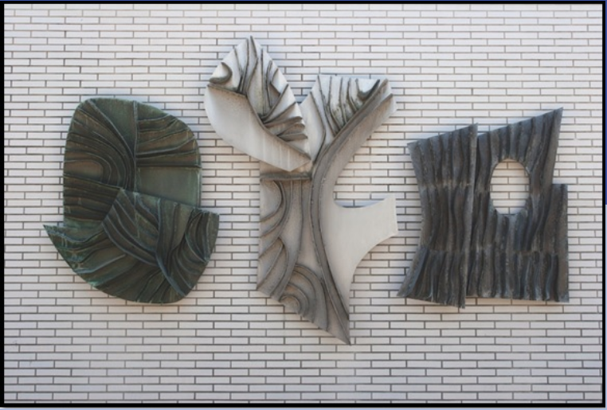
EDCP Peer Advisor October Event GTA+
Oct 9, 2025
Kieran Forde
Notes:
About Us https://edcp.educ.ubc.ca/about/
A Brief History of the Department of Curriculum and Pedagogy
https://edcp-educ.sites.olt.ubc.ca/files/2010/08/EDCPhistory.pdf
“The Scarfe Sculpture” https://kieranfor.de/2025/01/26/the-scarfe-sculpture/

Slide 2

Overview
TAs and FIPPA
Teams
Get involved
Get / stay informed
Killam & EDUC GTA
Extras
Zoom; Qualtrics; Camtasia etc.
Sessional Pro-D Fund
Sessional Tuition Waiver

Slide 3
TAs and FIPPA
The Freedom of Information and Protection of Privacy Act (FIPPA) requires UBC Teaching Assistants (TAs) to protect students' personal information by keeping it confidential and secure, avoiding unauthorized collection, use, or disclosure.
TAs must use their UBC email accounts (i.e. not Gmail etc.) for work-related communications to comply with data residency rules and security standards
TAs must also be aware of FIPPA guidelines when using learning technologies or handling any student records.
Notes:
edcpgradpeeradvisor@gmail.com

Slide 4
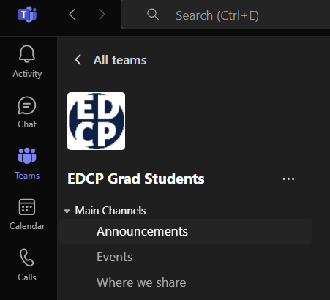
Teams
PIA Approved & UBC-Supported
Owned by EDCP Peer Advisors
Connecting people
Chat / Meetings / Calendar
Sharing information
Continuity of Community
Used widely in K-12
Show KF Teams
Notes:
Sign up for a Student Email Address https://it.ubc.ca/services/email-voice-internet/ubc-student-email-service
Choosing Learning Technologies: Student Privacy + FIPPA
https://lddi.educ.ubc.ca/student-privacy-fippa/
Team code: vdye9k2

Slide 5
Overview
TAs and FIPPA
Teams
Get involved
Get / stay informed
Killam & EDUC GTA
Extras
Zoom
Sessional Pro-D Fund
Sessional Tuition Waiver

Slide 6
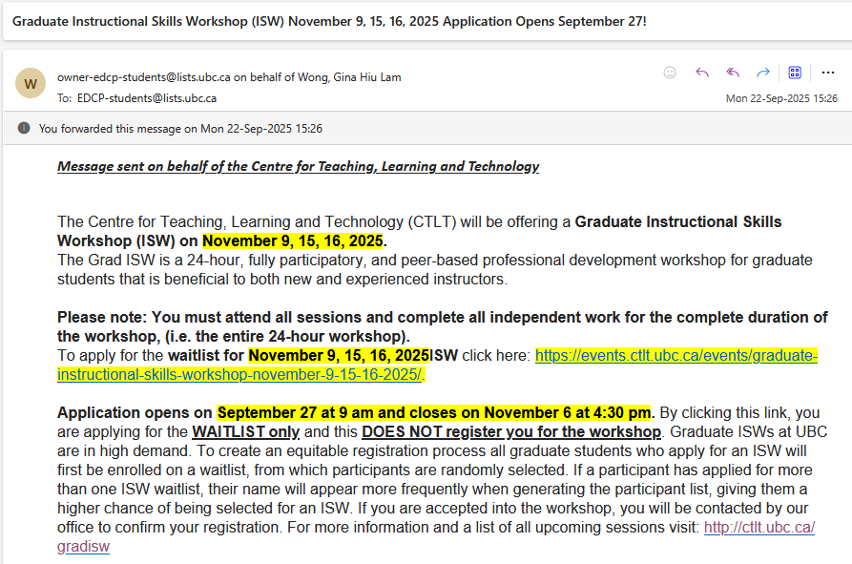

Slide 7
The Instructional Skills Workshop (ISW)
Initially designed for instructors at community colleges and institutes in British Columbia in 1979
In 1992, the UBC introduced the ISW as a program designed for teaching assistants.
Those who wish to facilitate ISW after taking it must take the 40-hour Facilitator Development Workshop (FDW)
Notes:
Instructional Skills Workshop
https://en.wikipedia.org/wiki/Instructional_Skills_Workshop

Slide 8
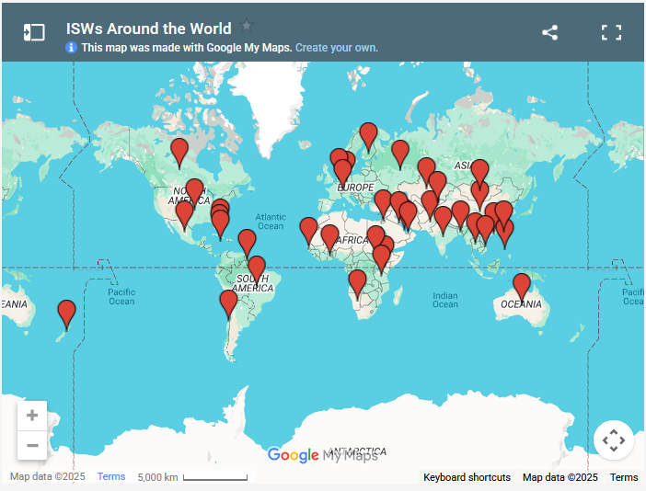
ISW Network
Notes:
ISW Network
https://www.iswnetwork.ca/isw-around-the-world/

Slide 9
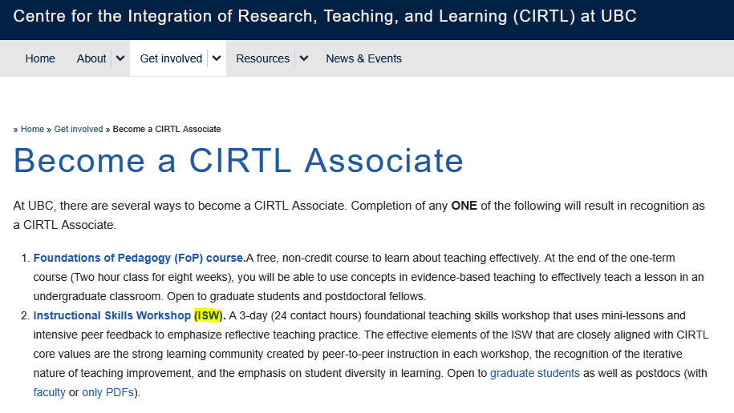
CIRTL

Slide 10

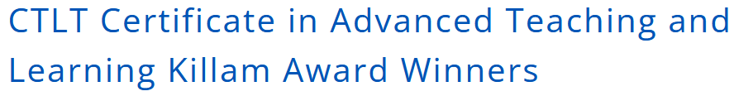
CATL
Notes:
Certificate Program in Advanced Teaching and Learning https://ctlt.ubc.ca/programs/graduate-student-ta-programs/graduate-program-in-advanced-teaching-and-learning/

Slide 11
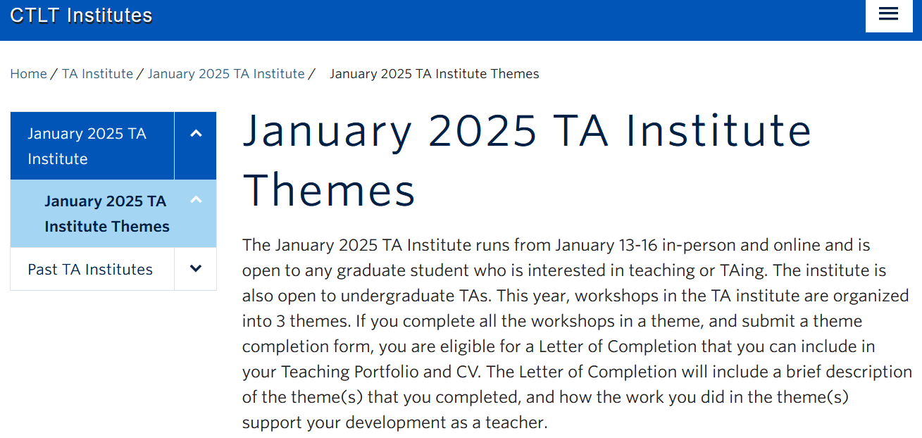
TA Institute
Notes:
January 2025 TA Institute Themes https://institute.ctlt.ubc.ca/ta-institute/ta-institute/january-2025-ta-institute-themes/

Slide 12

Graduate Students in Teaching Conference
Notes:
Graduate Students in Teaching Conference – May 6 + 7, 2025 https://events.ubc.ca/event/graduate-students-in-teaching-conference-may-6-7-2025__trashed/2025-05-06/

Slide 13


Notes:
Learning Technology Innovation Centre https://ltic.ubc.ca/

Slide 14
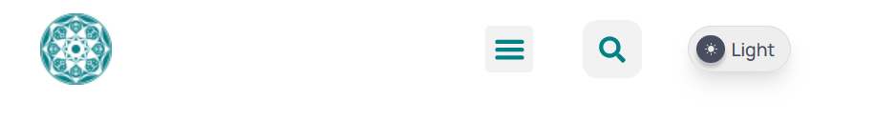
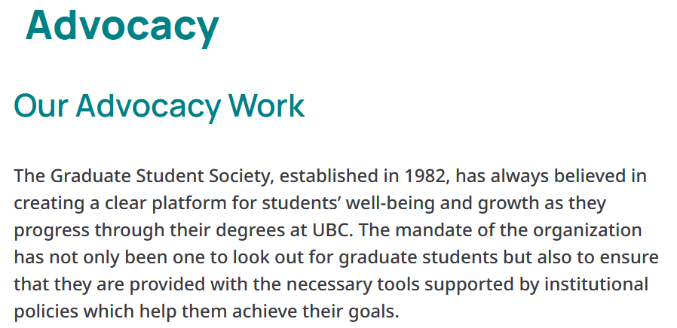
GSS

Slide 15
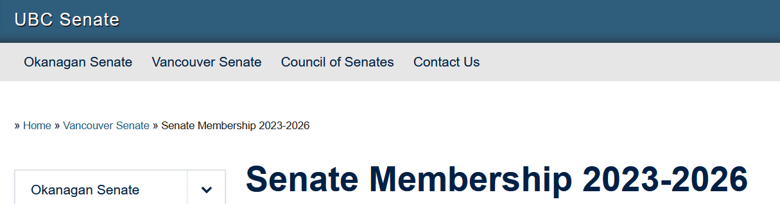

Senate
Notes:
https://senate.ubc.ca/vancouver/senate-membership-2023-2026/
Representative of the Students of the Faculty of Education
Vacancy (1)

Slide 16
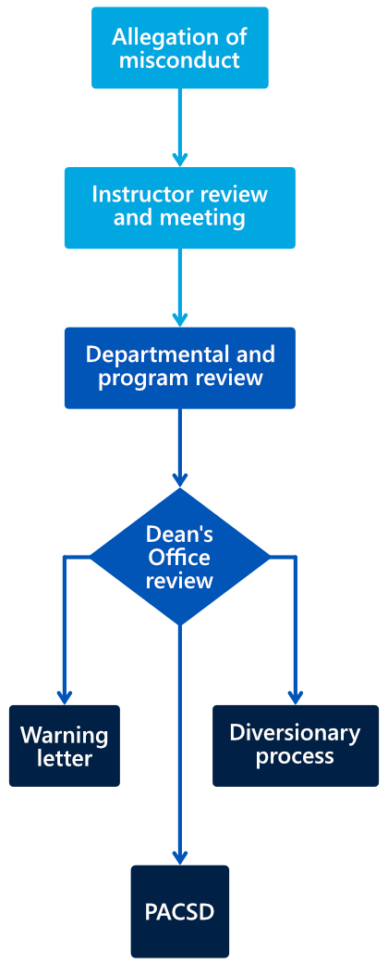
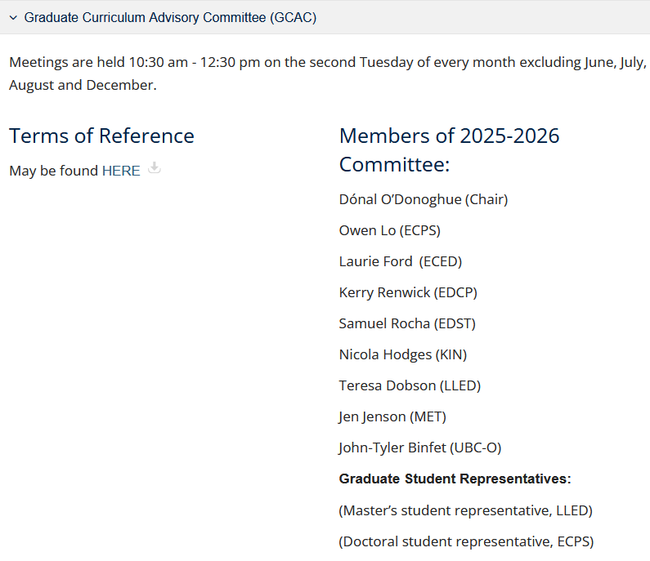
Committees
Notes:
Committees and Meetings
https://educ.ubc.ca/committees-and-meetings/

Slide 17
Overview
TAs and FIPPA
Teams
Get involved
Get / stay informed
Killam & EDUC GTA
Extras
Zoom
Sessional Pro-D Fund
Sessional Tuition Waiver

Slide 18
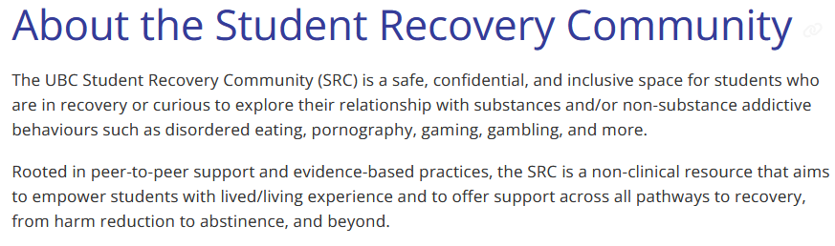
Student Recovery Community
Notes:
UBC Student Recovery Community (SRC) https://students.ubc.ca/health/ubc-student-recovery-community/

Slide 19
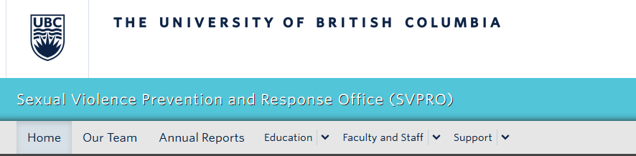

SVPRO / SASC
Notes:
SASC https://www.amssasc.ca/
SVPRO
https://svpro.ubc.ca/

Slide 20
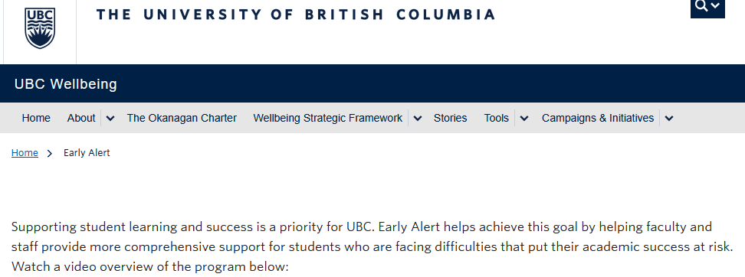
Early Alert
Notes:
Early Alert
https://wellbeing.ubc.ca/early-alert

Slide 21
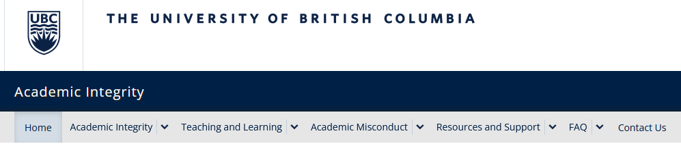
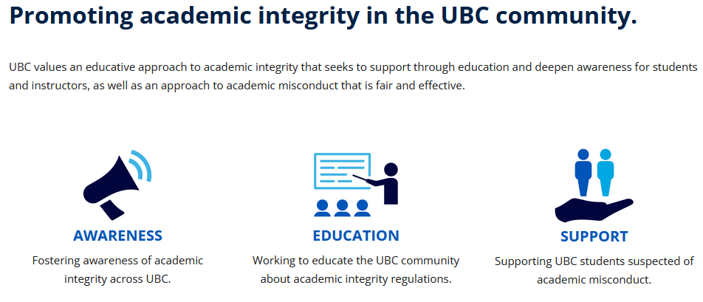
Office of Academic Integrity
Notes:
Academic Integrity at UBC
https://academicintegrity.ubc.ca/

Slide 22
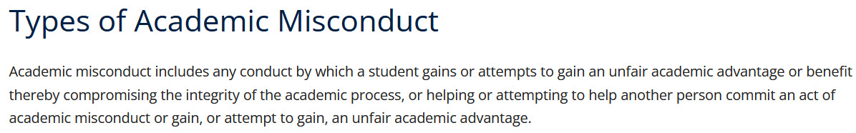
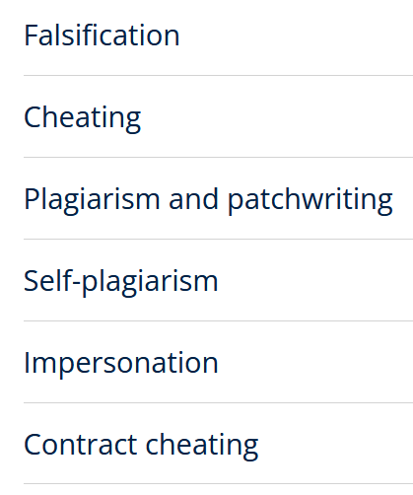
Academic Integrity
Notes:
Academic Misconduct https://academicintegrity.ubc.ca/regulation-process/academic-misconduct/

Slide 23
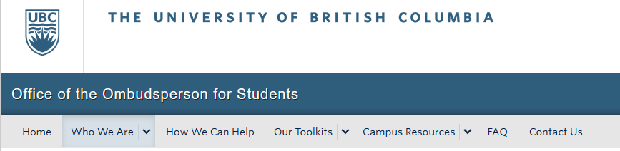
Ombuds Office
Notes:
Office of the Ombudsperson for Students
https://ombudsoffice.ubc.ca/

Slide 24
Overview
TAs and FIPPA
Teams
Get involved
Get / stay informed
Killam & EDUC GTA
Extras
Zoom
Sessional Pro-D Fund
Sessional Tuition Waiver

Slide 25
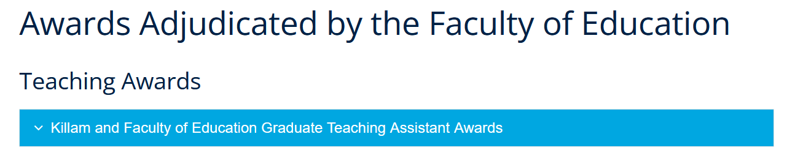
Notes:
Graduate Funding Opportunities
https://educ.ubc.ca/grad/graduate-funding-opportunities/

Slide 26
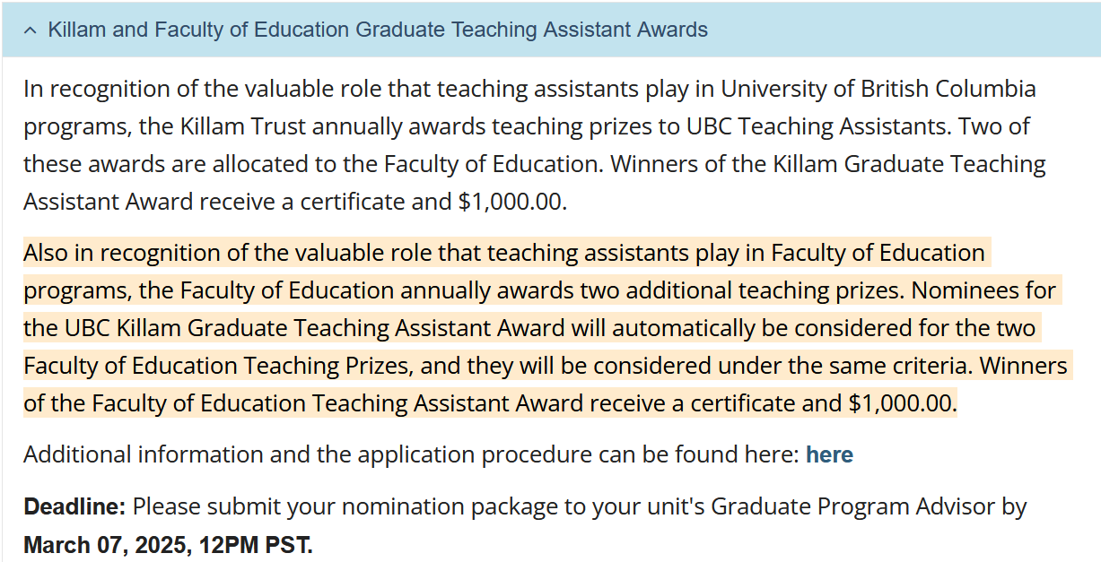
Notes:
Effective Teaching Criteria -- for Killam GTA Award Nominations https://academic.ubc.ca/sites/default/files/2024-11/Killam-GTA-Awards-Criteria.pdf

Slide 27
PDFs Effective Teaching Criteria -- for Killam GTA Award Nominations Guidelines for Preparing the Killam GTA Nomination Submissions

Slide 28
My example / experience

Slide 29
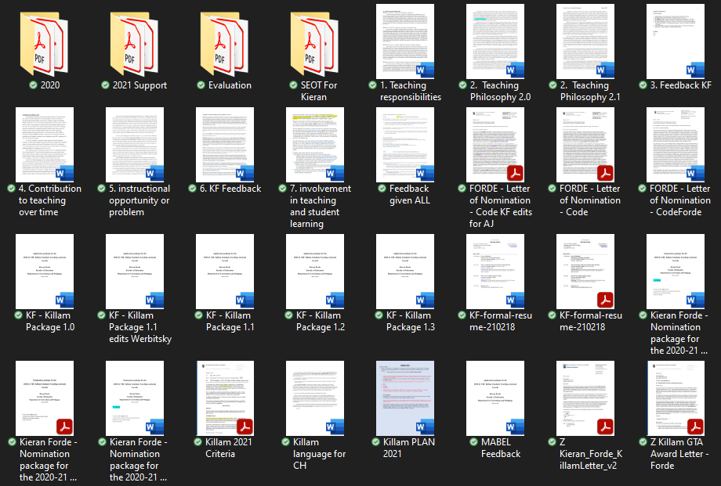
Notes:
KF Example

Slide 30
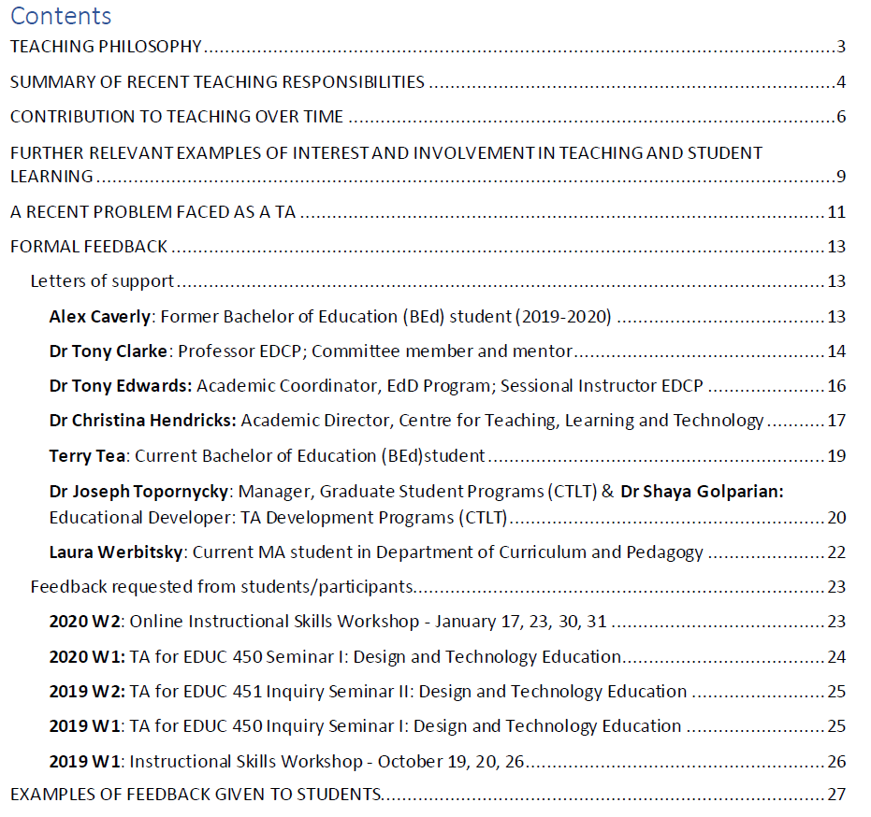
Notes:
KF Example

Slide 31
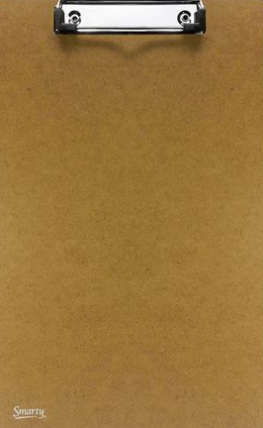


PAUSE

Slide 32
Extras ⬇

Slide 33
Sessional Pro-D Fund
Notes:
Faculty professional development funding https://hr.ubc.ca/career-development/professional-development-funding/faculty-professional-development-funding

Slide 34
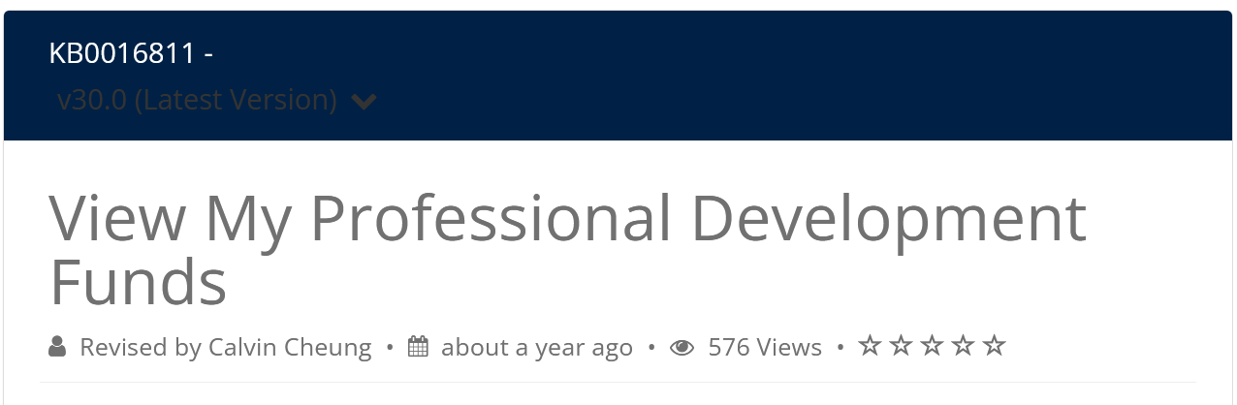
View My Professional Development Funds
Notes:
View My Professional Development Funds https://ubc.service-now.com/selfservice?id=kb_article&sysparm_article=KB0016811

Slide 35
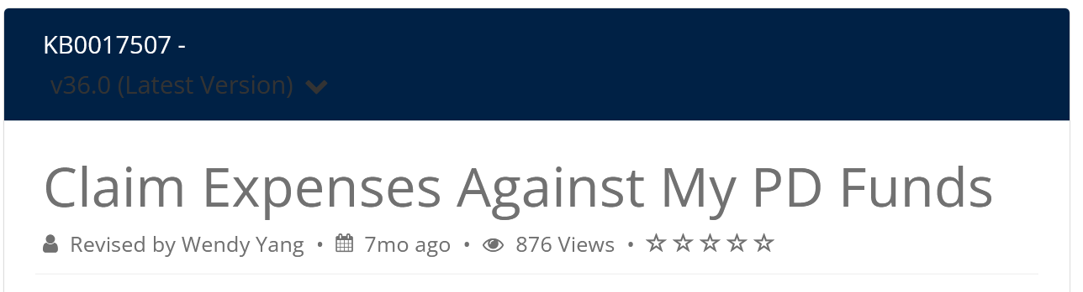
Claim Expenses Against My PD Funds
Notes:
Claim Expenses Against My PD Funds https://ubc.service-now.com/selfservice?id=kb_article&sysparm_article=KB0017507

Slide 36
Sessional Tuition Waiver
Notes:
Tuition waivers
https://hr.ubc.ca/benefits/benefit-plan-details/tuition-waivers

Slide 37
PAUSE

Slide 38
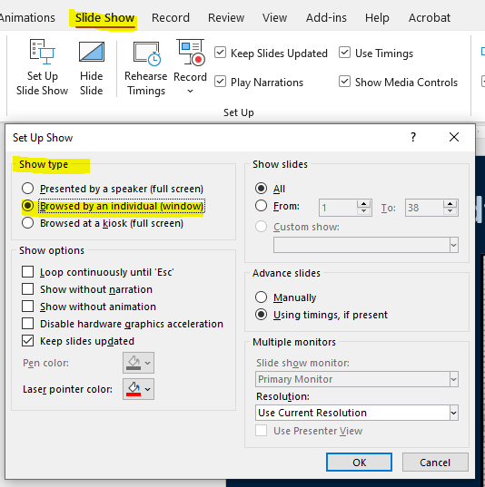

Slide 39

Fin

