Slide 1

Notes:
The ancestral laws of this land require that anyone who is not from one of the host nations needs to make a declaration before doing any work here.
My name is Kieran Forde. I am from Galway, in Ireland.
I am here on the lands of the Musqueam Nation to teach and learn, in my current role until the end of this year.
I am thankful to the Musqueam Nation who are hosting us and allowing us to do this work on their territory.
The Truth Behind Land Acknowledgements - May 12, 2025
https://www.youtube.com/watch?v=9f4dIE3kgv4&ab_channel=KPUArts

Slide 2


Be(com)ing a teacher:
Private citizen / Public servant
June 17, 2025 (BEds)
Kieran Forde
➡ bit.ly/BCK12
Notes:
Distribute scissors
Lipdub @-10
https://www.youtube.com/watch?v=Dpp3quce1Vo&ab_channel=UBCLipdub
BC Public Service teachers
https://www2.gov.bc.ca/gov/content/careers-myhr/all-employees/pay-benefits/salaries/salarylookuptool/pea-jobs/teacher
Peña Carranco, L. E. (2016, April 30). The concept of legal literacy amongst educators in Canada [G]. https://open.library.ubc.ca/soa/cIRcle/collections/graduateresearch/42591/items/1.0347618
JUMP TO: number & Enter [Line = 93]

Slide 3


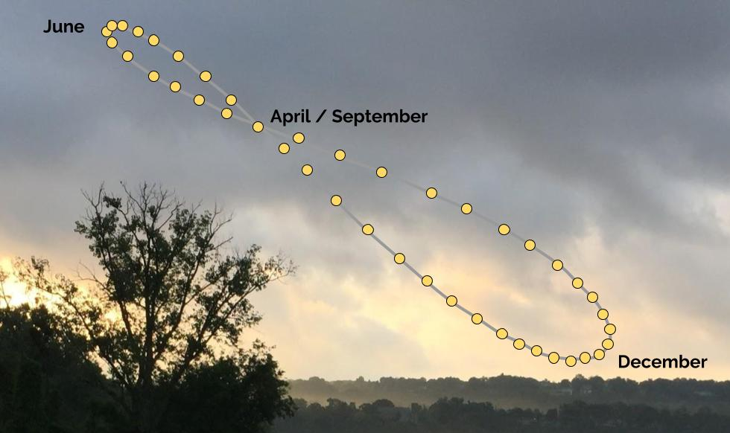







Analemma
Notes:
“The Métis flag or flag of the Métis Nation features a white infinity sign on a blue background. The infinity symbol represents the mixing of two distinct cultures, European and First Nations, to create a unique and distinct culture, that of the Métis (which means “to mix” in Latin).”
https://www.ictinc.ca/blog/the-metis-flag
Stellarium – See the Analemma
https://starinastar.com/stellarium-see-analemma/
Petresin, V., & Robert, L.-P. (2002). The Double Möbius Strip Studies. Nexus Network Journal, 4(2), 54–64. https://doi.org/10.1007/s00004-002-0015-3

Slide 4

Be(com)ing

Slide 5


Identity
Notes:
LAND ACKNOWLEDGEMENT
Most of my time here on this UBC campus.
I recall hearing the former Dean of Education speak of the “traditional, ancestral, unceded, and occupied territory of the Musqueam people.”
How this word was shocking to me, familiar, and speaking of responsibilities I continue to explore as a Canadian citizen.
“Locally, at any single point, we can see a distinct inner and outer side, suggesting a clear conflicting relationship. But globally, if we look at the entire model, we cannot see where one side turns to the other side” (Yang, 2018).
Yang, C. (2018, January 7). Lacan and His Mobius Strip. Chroma. https://chroma.mit.edu/p/lacan-and-his-mobius-strip

Slide 6

Praxis

Slide 7

Identity
Professional/personal
Notes:
Maxwell, B. (2018). When teachers' off-duty creative pursuits conflict with role model expectations: A critical analysis of “Shewan". Interchange: A Quarterly Review of Education, 49(2), 161-178. https://doi.org/10.1007/s10780-018-9320-y

Slide 8

“Teaching is a dual act of intelligence and empathy.
It entails both technical and moral reason” - Shulman (1997)
/ /
Teach(er)
Notes:
Shulman, L. S. (1997). Teaching as community property: Essays on higher education. Jossey-Bass.
“Teaching is a dual act of intelligence and empathy.
It entails both technical and moral reason”
- Shulman (1997)

Slide 9


Slide 10


Slide 11


Slide 12
  A good teacher must stand where personal and public meet, dealing with the thundering flow of traffic at an intersection where ‘weaving a web of connectedness’ feels more like crossing a freeway on foot.”
  - Parker Palmer, The Courage to Teach
Notes:
“Unlike many professions, teaching is always done at the dangerous intersection of personal and public life.
A good therapist must work in a personal way, but never publicly…
A good trial lawyer must work in a public forum but remain unswayed by personal opinion…

Slide 13



Slide 14



Slide 15


Slide 16


Slide 17
“Unlike other professions, teachers never lose their characterisation as a teacher, regardless of the circumstances of a situation. In Canadian society today, a teacher is a teacher, 24 hours of the day, seven days of the week.”
- Anderson, S. & Fraser, S. (2001). Protecting our students (and their teachers too).
Notes:
Anderson, S. & Fraser, S. (2001). Protecting our students (and their teachers too). A Canadian perspective. Australia & New Zealand of Law & Education. 6(1), 55-86.

Slide 18


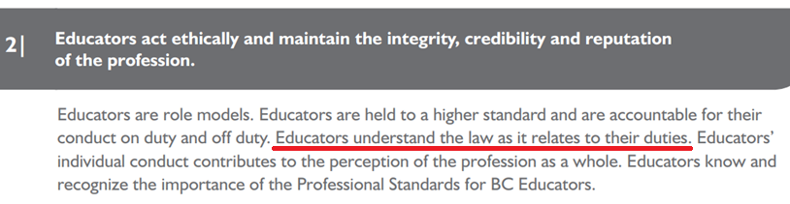
Notes:
Professional Standards for BC Educators
https://www2.gov.bc.ca/assets/gov/education/kindergarten-to-grade-12/teach/teacher-regulation/standards-for-educators/edu_standards.pdf
Hands up!
Standard #9 https://kieranfor.de/2025/02/11/standard-9/

Slide 20
A Möbius Trip: Part 1
The Legal Framework: Federal & Provincial
The Canadian Charter of Rights and Freedoms
Seminal Cases
Duty to Report
Teacher as Role Model
Teacher as Change Agent
Curriculum as Contested
Inquiry
A Möbius Trip: Part 2
Extras

Slide 21
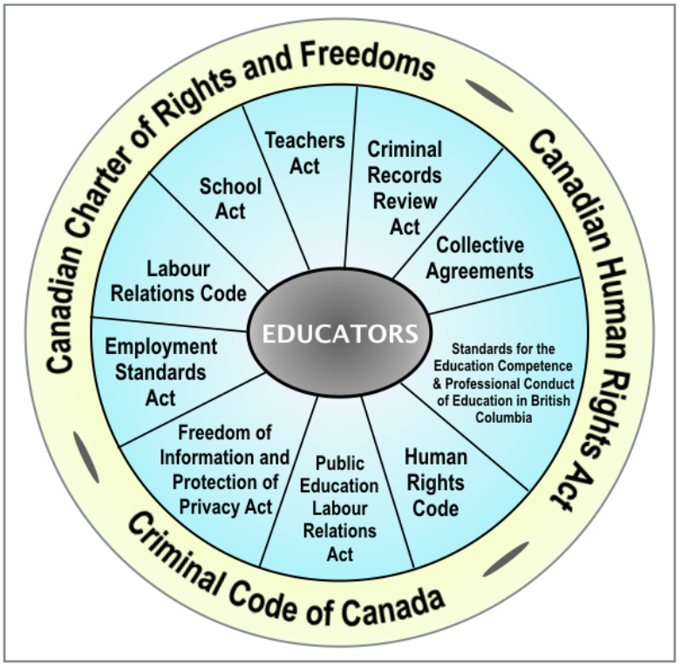

Federal Jurisdiction
Provincial Jurisdiction
Peña Carranco (2016) [MEd] The concept of legal literacy amongst educators in Canada
Notes:
Peña Carranco, L. E. (2016, April 30). The concept of legal literacy amongst educators in Canada [G]. http://dx.doi.org/10.14288/1.0347618
Legal framework that regulates educators in British Columbia. The figure provides a graphical description of the federal jurisdiction (in the outer yellow circle) and the provincial jurisdiction (in the blue circle) that hold educators to account.

Slide 22
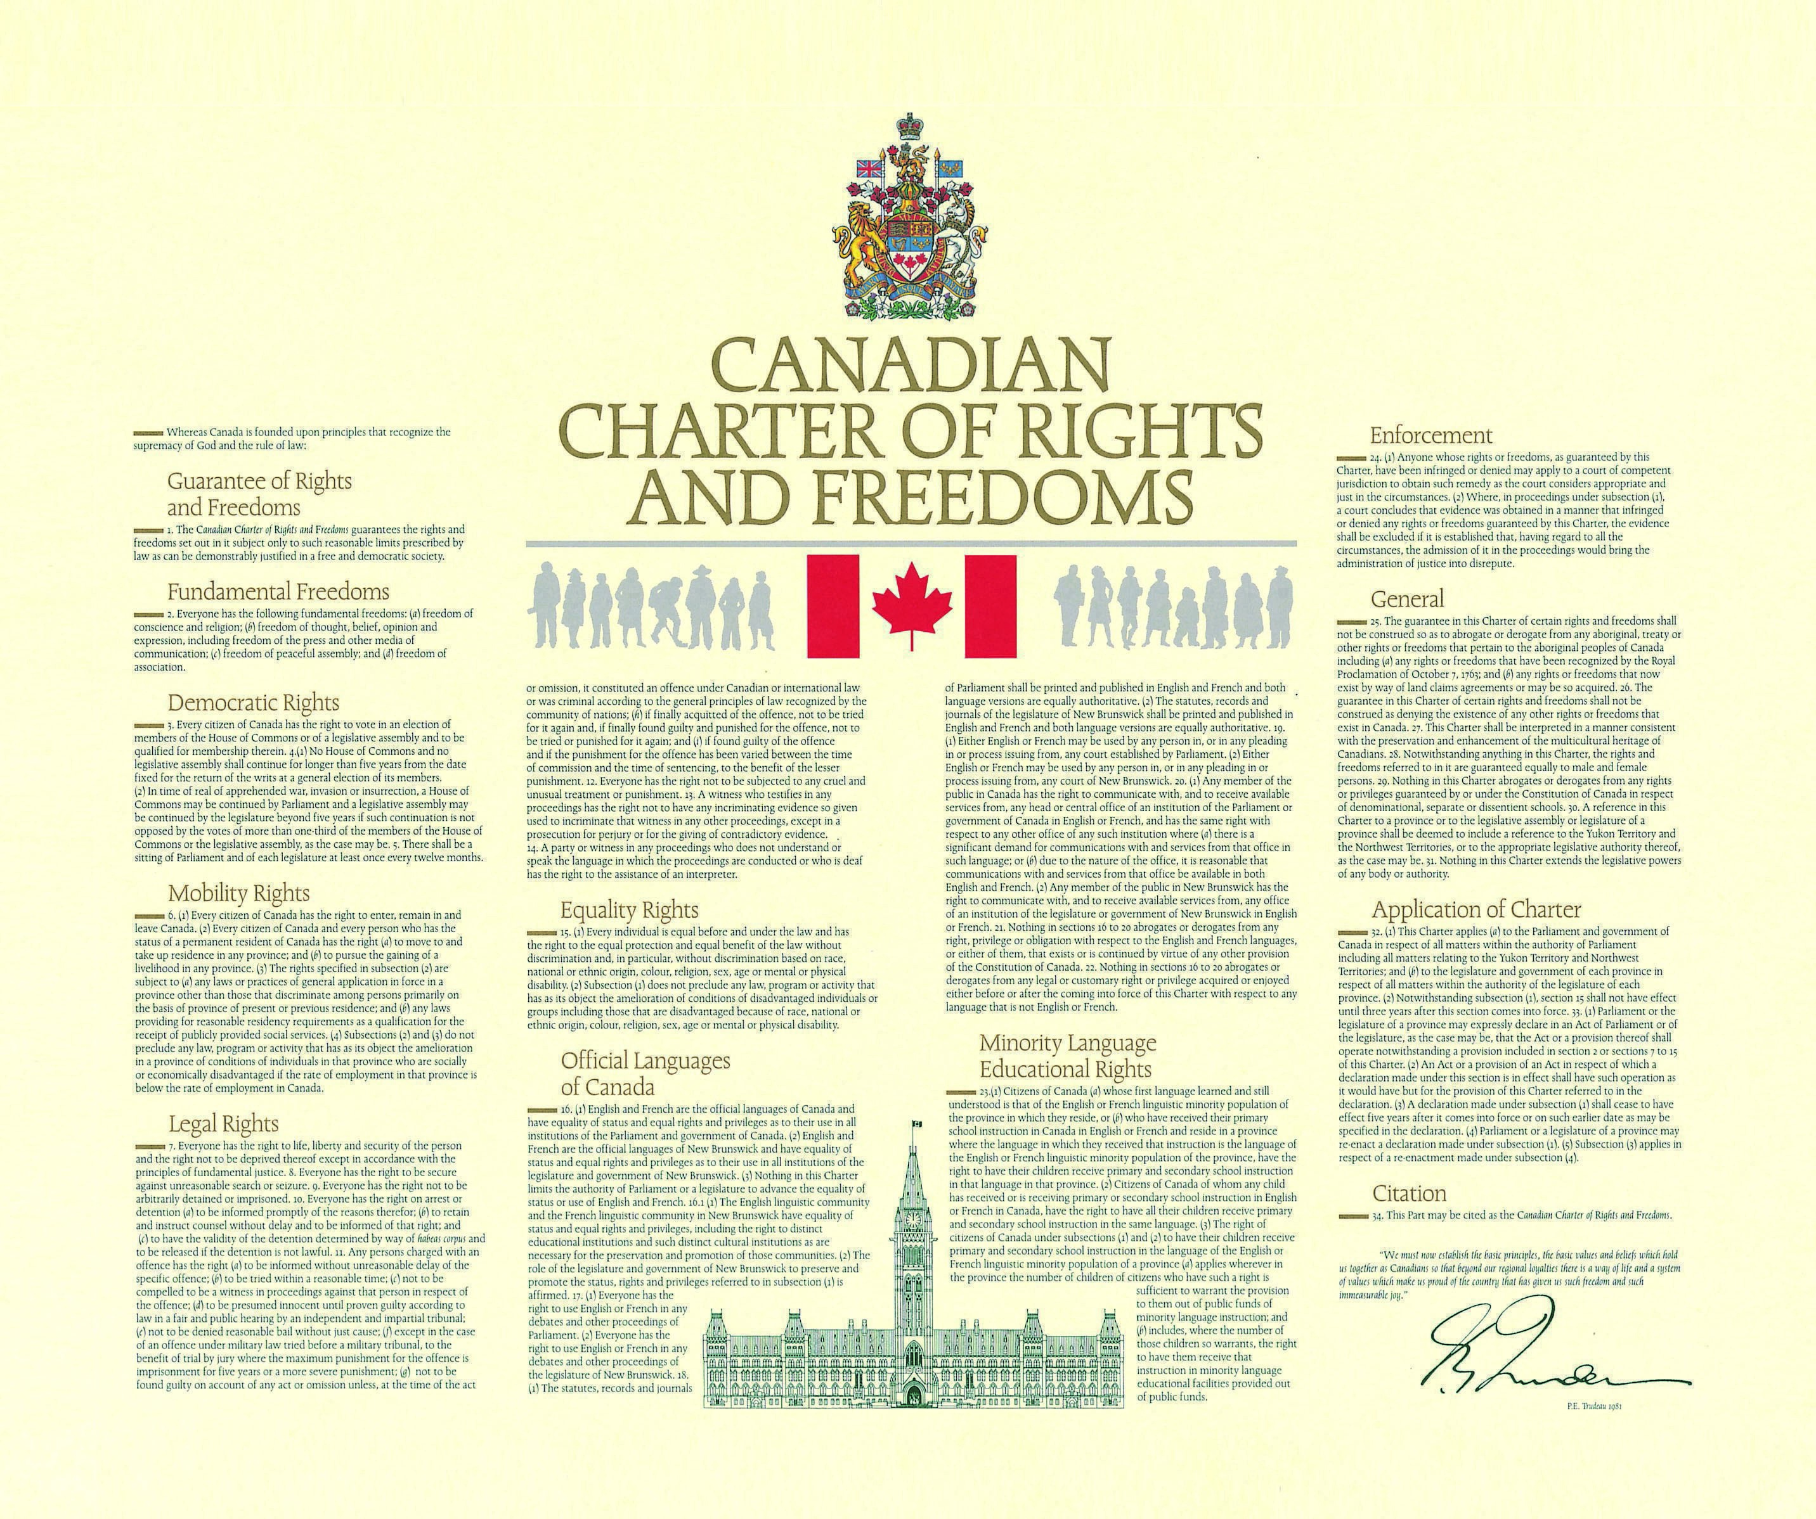
      1982
Notes:
Supreme Law: National Film Board of Canada
https://supremelaw.nfb.ca/deepdives/legacy-the-charter/
Through this educational supplement to Supreme Law, explore the history and legacy of that pivotal event and what it means for Canadians today.

Slide 23
How are your fundamental freedoms,
guaranteed by “The Charter”,
recontextualized when you become a
public-school teacher?
1

Slide 24
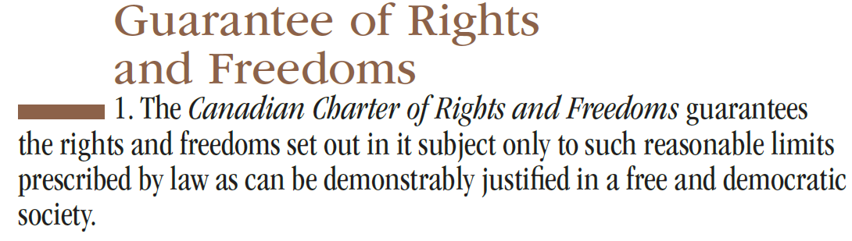
Section 1
/
15
Notes:
Canadian Charter of Rights and Freedoms
https://www.canada.ca/en/canadian-heritage/services/download-order-charter-bill.html#a1
The Right to Protest is a Charter protected Right and Freedom in Canada.
That right includes the responsibility to ensure protestors aren't physically impeding nor blocking the lawful activities of others.
https://twitter.com/RightsOfCanada/status/1543076100049354752

Slide 25

Section 15 (equality rights)
Section 15 of the Charter makes it clear that every individual in Canada – regardless of race, religion, national or ethnic origin, colour, sex, age or physical or mental disability – is to be treated with the same respect, dignity and consideration. This means that governments must not discriminate on any of these grounds in its laws or programs.
Notes:
"Although sexual orientation is not explicitly mentioned as a guaranteed right under Section 15 of the Charter, recent court cases…have established sexual orientation as an analogous ground, warranting protection under Section 15." (Shariff, 2001)
Shariff, S. (2001). The case of school censorshop: The charter of rights and freedoms. Orbit (Toronto), 32(2), 7.

Slide 26


Section 27
“This Charter shall be interpreted in a manner consistent with the preservation and enhancement of the multicultural heritage of Canadians.”
Notes:
https://twitter.com/MbizBizy/status/1541394815211937794
“This Canada Multiculturalism Day should redefined and named “Canada Inclusion Day” that can be more accepted in #Quebec in my humble opinion”
𝐌𝐮𝐥𝐭𝐢𝐜𝐮𝐥𝐭𝐮𝐫𝐚𝐥𝐢𝐬𝐦
https://www.thecanadianencyclopedia.ca/en/article/multiculturalism
𝐖𝐚𝐫 𝐨𝐟 𝐰𝐨𝐫𝐝𝐬: 𝐢𝐧𝐭𝐞𝐫𝐜𝐮𝐥𝐭𝐮𝐫𝐚𝐥𝐢𝐬𝐦 𝐯. 𝐦𝐮𝐥𝐭𝐢𝐜𝐮𝐥𝐭𝐮𝐫𝐚𝐥𝐢𝐬𝐦
https://comparativemigrationstudies.springeropen.com/articles/10.1186/s40878-018-0079-1
(Mar 2, 2006) Ban on Sikh kirpan overturned by Supreme Court
https://www.cbc.ca/news/canada/ban-on-sikh-kirpan-overturned-by-supreme-court-1.618238
Louie, D. W. (2024). Barriers to Engaging with Reconciliation in Canadian Education: Confusing Colonial and Western Knowledge. Canadian Journal of Education Revue Canadienne De l’éducation, 47(2), 466–491. https://doi.org/10.53967/cje-rce.6325
St. Denis (2011) challenges multiculturalism by claiming it does not address racism in our society and that Indigenous people are not simply just one amongst a myriad of cultures in the Canadian context.

Slide 27
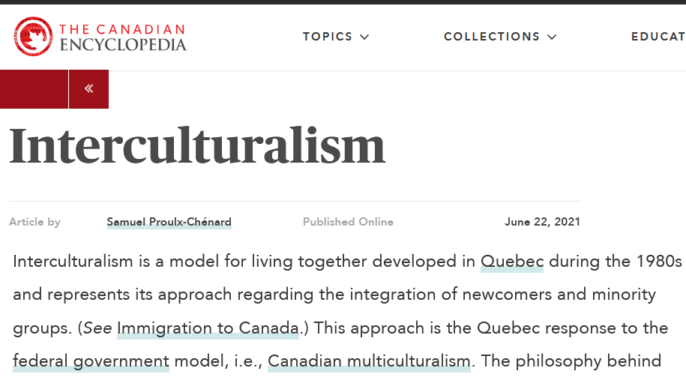

Slide 28
      Section 33

Slide 29
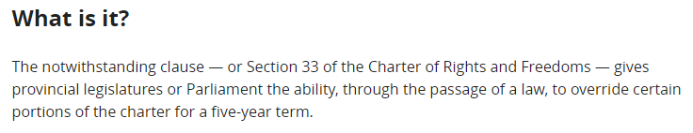
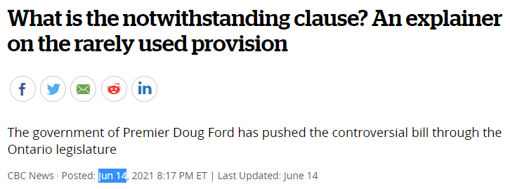

Section 33 (the notwithstanding clause)
Federal
Provincial
Notes:
What is the notwithstanding clause? An explainer on the rarely used provision
https://www.cbc.ca/news/canada/toronto/ontario-notwithstanding-explainer-1.6065686

Slide 30
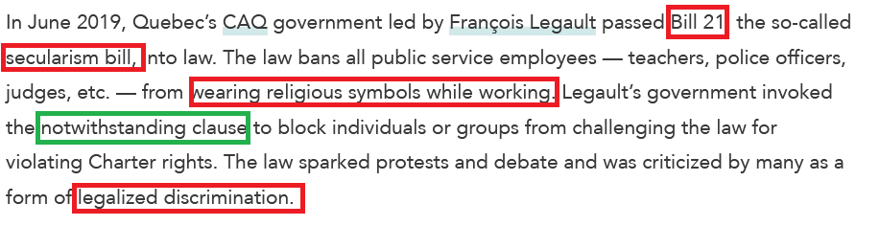

Section 33 (The Notwithstanding Clause)
Notes:
Canadian Charter of Rights and Freedoms
https://www.thecanadianencyclopedia.ca/en/article/canadian-charter-of-rights-and-freedoms
(Feb 29, 2024) Appeal Court upholds Quebec law that bars teachers, police from wearing religious symbols
https://www.cbc.ca/news/canada/montreal/quebec-appeal-court-decision-bill-21-1.7128447
(Mar 20, 2025) Quebec to expand religious symbol ban, force students to uncover faces https://globalnews.ca/news/11090102/quebec-secularism-schools-new-bill/

Slide 31
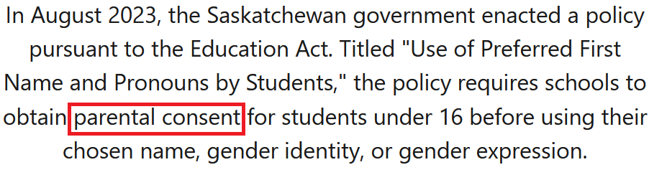
Section 33 (The Notwithstanding Clause)
"outing requirement” // "misgendering requirement”
September 19, 2023, injunction granted
Passed into law on October 20, 2023
Notes:
Saskatchewan and the notwithstanding clause explained
https://www.cbc.ca/news/politics/moe-saskatchewan-notwithstanding-explained-1.6982715#
(Sept 26, 2024) Democracy’s Sledgehammer: The Use of the Notwithstanding Clause for Saskatchewan’s Bill 137, “The Parent’s Bill of Rights”
https://www.schoolofpublicpolicy.sk.ca/research-ideas/publications-and-policy-insight/policy-brief/bill-137.php
(Feb 24, 2025) Saskatchewan’s ‘because I said so’ approach
https://www.nationalmagazine.ca/en-ca/articles/law/opinion/2025/saskatchewan-s-‘because-i-said-so-approach

Slide 32
      Section 2

Slide 33
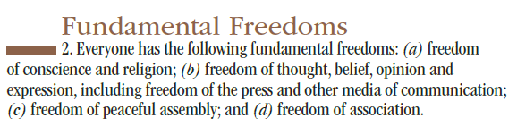
Section 2
Notes:
https://x.com/RightsOfCanada/status/1543076100049354752

Slide 34
On expression
“Expression isn’t just limited to the things we say; it can come in many forms, from the written word, to music, or physical gestures. Even the act of being silent can convey meaning!
(Canadian Civil Liberties Association, 2018)
Notes:
Irwin Toy Ltd. v. Québec (A.G.), 1989, 1 S.C.R. 927, https://scc-csc.lexum.com/scc-csc/scc-csc/en/item/443/index.do
Canadian Civil Liberties Association. (2018, June). Freedom of Expression 101. https://ccla.org/cclanewsite/wp-content/uploads/2018/06/Freedom-of-Expression-101-FINAL.pdf

Slide 35
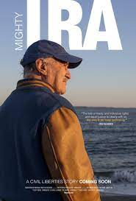
On expression
  Content neutrality
      “such that the content of expression, no matter how offensive, unpopular or disturbing, cannot deprive it of section 2(b) protection”
      (Canadian Civil Liberties Association, 2018)
Mighty Ira (2020)
Notes:
Canadian Civil Liberties Association. (2018, June). Freedom of Expression 101. https://ccla.org/cclanewsite/wp-content/uploads/2018/06/Freedom-of-Expression-101-FINAL.pdf

Slide 36

On expression
Forced /compelled speech
    “When speech is merely restricted, you can at least keep your thoughts to yourself. Forced speech makes people say things with which they do not agree.”
A Man for All Seasons (1966)
Bruce Pardy, Senate of Canada, 2017:
re C-16; gender identity rights
Notes:
(n.d.) Canada’s gender identity rights Bill C-16 explained https://www.cbc.ca/cbcdocspov/features/canadas-gender-identity-rights-bill-c-16-explained
Senate of Canada. (2017, May 17). The Standing Senate Committee on Legal and Constitutional Affairs: Consideration of Bill C-16. https://sencanada.ca/en/Content/SEN/Committee/421/lcjc/53339-e
Declining / refusing ; inviting / demanding

Slide 37

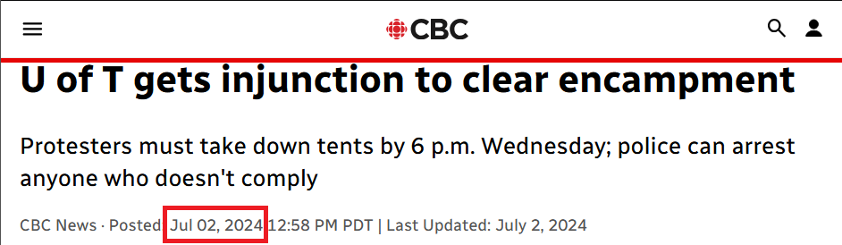
On expression
“Reasonable limits”
Protest ≠ occupy
Notes:
The Ontario Superior Court of Justice ruled Tuesday that protesters must take down tents in an area known as King's College Circle by Wednesday at 6 p.m.
https://www.cbc.ca/news/canada/toronto/decision-university-toronto-injunction-encampment-1.7252343
(Oct 12, 2011) When is it hate speech?: 7 significant Canadian cases
https://www.cbc.ca/news/canada/when-is-it-hate-speech-7-significant-canadian-cases-1.1036731

Slide 38
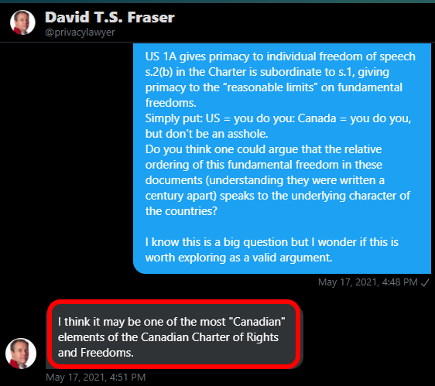
On US Freedom of Speech
V
Canadian Freedom of Expression
Notes:
David Fraser: https://twitter.com/privacylawyer
Part-time Faculty Member: Dalhousie Law School: Sep 2001 – Present
Teaching responsibilities have included "Internet and Media Law" and "Law and Policy for E-Commerce". Associate of the Law and Technology Institute.
religion, speech, press, assembly, and the right to petition the government

Slide 39


A Möbius Trip: Part 1
The Legal Framework: Federal & Provincial
The Canadian Charter of Rights and Freedoms
Seminal Cases
Duty to Report
Teacher as Role Model
Teacher as Change Agent
Curriculum as Contested
Inquiry
A Möbius Trip: Part 2
Extras

Slide 40
1986: Cromer v. British Columbia Teacher’s Federation
Parents?
A middle school teacher was charged by BCTF for voicing derogatory comments about a colleague during a Parent Advisory Council meeting in breach of cl. 5 of the Federation's Code of Ethics.
“The teacher argued that she had been speaking as a parent on that occasion, and contended that the charge infringed her freedom of speech”
Notes:
Spetch, E.A., Manley-Casimir, M. & Piddocke, S.M. (2004). Teacher Incompetence, Misconduct and Dismissal in British Columbia: An Archival Analysis (1962–1987). Brock Education, 13(2), 27-49 https://doi.org/10.26522/brocked.v13i2.49
Maxwell, B. (2018). When teachers' off-duty creative pursuits conflict with role model expectations: A critical analysis of “Shewan". Interchange: A Quarterly Review of Education, 49(2), 161-178. https://doi.org/10.1007/s10780-018-9320-y

Slide 41
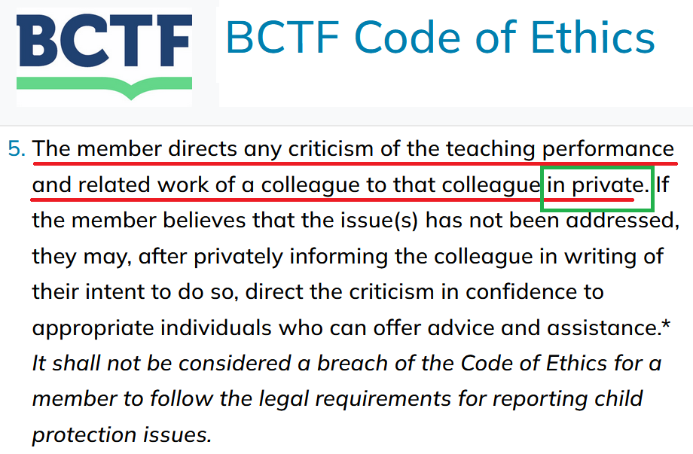
⬅ Duty to Report
Notes:
https://www.bctf.ca/topics/services-information/professional-conduct-and-regulation/code-of-ethics

Slide 42
1986: Cromer v. British Columbia Teacher’s Federation
Decision:
SCC dismissed the appeal stating that teachers do not get to “choose which hat they will wear on what occasion.”
Notes:
Oliverio, C., & Manley-Casimir, M. (2005). The judicial construction of the role of the teacher. McGill Journal of Education, 40(3), 405.

Slide 43
1987: Shewan and Shewan v. Abbotsford School District No. 34
“John and Ilze Shewan, husband and wife, were both teachers employed by Abbotsford School District (#34). They started a controversy by winning a subsidiary prize in an amateur photo contest in Gallery magazine, for a seminude photograph of Ilze Shewan.” (Spetch et al., 2014, p. 42)
This was “the first post-Charter legal precedent where judges affirmed that individual teachers have a professional responsibility to maintain public trust and confidence in teaching and the education system and, further, that off-duty teacher conduct that substantially undermines that trust can be legitimately subject to professional sanction.” (Maxwell, 2018, p. 164)
Notes:
Spetch, E.A., Manley-Casimir, M. & Piddocke, S.M. (2004). Teacher Incompetence, Misconduct and Dismissal in British Columbia: An Archival Analysis (1962–1987). Brock Education, 13(2), 27-49 https://doi.org/10.26522/brocked.v13i2.49
Maxwell, B. (2018). When teachers' off-duty creative pursuits conflict with role model expectations: A critical analysis of “Shewan". Interchange: A Quarterly Review of Education, 49(2), 161-178. https://doi.org/10.1007/s10780-018-9320-y

Slide 44
1990 R. v. Keegstra
a secondary school teacher (and Mayor) in rural Alberta who taught anti-Semitic propaganda to his students (in class)
  was charged with a hate crime in 1984 and was found guilty in 1985
(SCC) All seven presiding justices ruled that the Criminal Code’s proscription on hate speech had indeed violated Keegstra’s freedom of expression, as protected by section 2 (b) of the Charter.
  However, four justices also stated that the law Keegstra had broken by expressing his anti-Semitic beliefs represented a “reasonable limit” on a citizen’s freedom of expression.
Notes:
Keegstra Case https://www.thecanadianencyclopedia.ca/en/article/keegstra-case
(October 12, 2011) When is it hate speech?: 7 significant Canadian cases
https://www.cbc.ca/news/canada/when-is-it-hate-speech-7-significant-canadian-cases-1.1036731
BILL C-19: The budget's criminalization of the Holocaust denial https://twitter.com/Paulatics/status/1537078472820006915

Slide 45
1996 Ross v. New Brunswick School District No. 15
Malcolm Ross, a New Brunswick high school teacher, publicly made racist and discriminatory comments against Jews during his off-duty time until a parent filed a human rights complaint against the school board.
Although these orders [removing him from his teaching position] interfered with Ross’s freedom of religion and expression under subsections 2(a) and 2(b), respectively, the Court applied section 1 of the Charter and found that they were reasonable and demonstrably justified limits on such rights. (Dickenson, 2005, p. 86)
Notes:
Dickinson, G. M. (2005). The problem of heretic teachers: Kempling v. British Columbia College of Teachers. McGill Journal of Education, 40(3), 383–404.

Slide 46

A Möbius Trip: Part 1
The Legal Framework: Federal & Provincial
The Canadian Charter of Rights and Freedoms
Seminal Cases
Duty to Report
Teacher as Role Model
Teacher as Change Agent
Curriculum as Contested
Inquiry
A Möbius Trip: Part 2
Extras

Slide 47

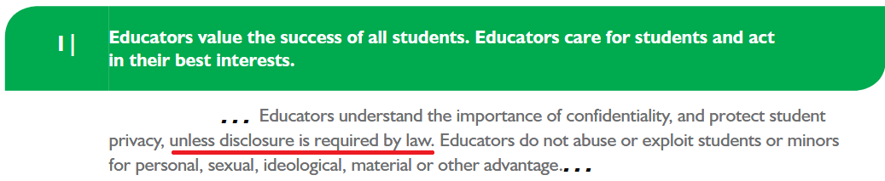
“…protect student privacy, unless disclosure is required by law.”
Notes:
Professional Standards for BC Educators
https://www2.gov.bc.ca/assets/gov/education/kindergarten-to-grade-12/teach/teacher-regulation/standards-for-educators/edu_standards.pdf

Slide 48
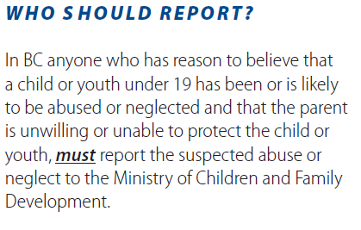
1/2
Notes:
Duty to Report - Reporting Concerns About Children And Youth
https://www2.gov.bc.ca/assets/gov/public-safety-and-emergency-services/public-safety/protecting-children/t15-0191_dutytoreport_pamphlet11x85in2folds.pdf

Slide 49
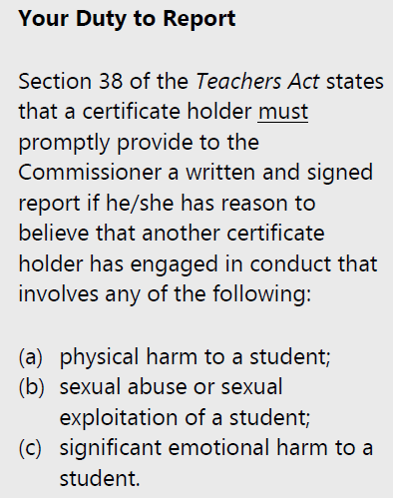
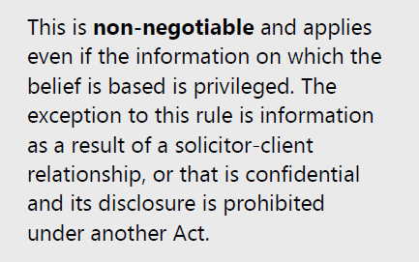
2/2
Notes:
Understanding Your Duty to Report
https://www2.gov.bc.ca/assets/gov/education/kindergarten-to-grade-12/teach/teacher-regulation/standards-for-educators/duty_to_report.pdf

Slide 50
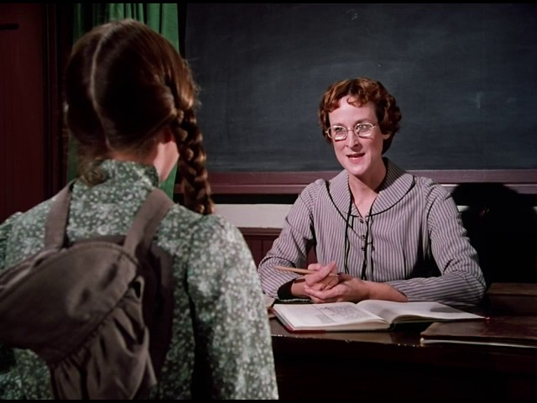
A Möbius Trip: Part 1
The Legal Framework: Federal & Provincial
The Canadian Charter of Rights and Freedoms
Seminal Cases
Duty to Report
Teacher as Role Model
Teacher as Change Agent
Curriculum as Contested
Inquiry
A Möbius Trip: Part 2
Extras
Notes:
Season 6 Episode 2 Back to School Part 2 Little House on the Prairie
https://www.youtube.com/watch?v=qGD4UOh75Bg
Miss Beadle>Ms. Eliza Jane Wilder

Slide 51
Teachers as role models
Horace Mann:
"The school committee are sentinels stationed at the door of every school house in the State, to see that no teacher crosses its threshold, who is not clothed, from the crown of his head to the sole of his foot, in garments of virtue; and they are the enemies of the human race,-not of contemporaries only, but of posterity,- who, for any private or sinister motive, strive to put these sentinels to sleep, in order that one, who is profane, or intemperate, or addicted to low associations, or branded with the stigma of any vice, may elude the vigilance of the watchmen, and be installed over the pure minds of the young, as their guide and exemplar…" (Common School Journal, 1841, p. 319)
Notes:
Horace Mann: "The school committee are sentinels stationed at the door of every school house in the State, to see that no teacher crosses its threshold, who is not clothed, from the crown of his head to the sole of his foot, in garments of virtue; and they are the enemies of the human race,-not of contemporaries only, but of posterity,- who, for any private or sinister motive, strive to put these sentinels to sleep, in order that one, who is profane, or intemperate, or addicted to low associations, or branded with the stigma of any vice, may elude the vigilance of the watchmen, and be installed over the pure minds of the young, as their guide and exemplar…" (Common School Journal, 1841, p. 319)
/90e02

Slide 52
Teachers as role models
(Current) Ontario Education Act: Clause 264 (1) (c)
“It is the duty of a teacher and a temporary teacher … to inculcate by precept and example respect for religion and the principles of Judaeo-Christian morality and the highest regard for truth, justice, loyalty, love of country, humanity, benevolence, sobriety, industry, frugality, purity, temperance and all other virtues.”
Notes:
Ontario Education Act Clause 264 (1) (c) https://www.ontario.ca/laws/statute/90e02

Slide 53
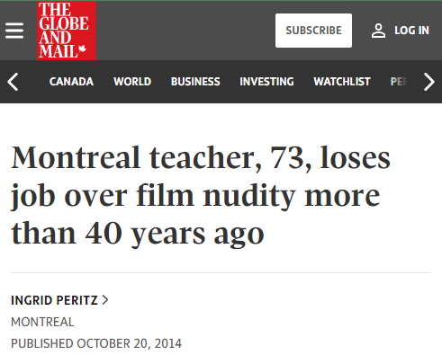
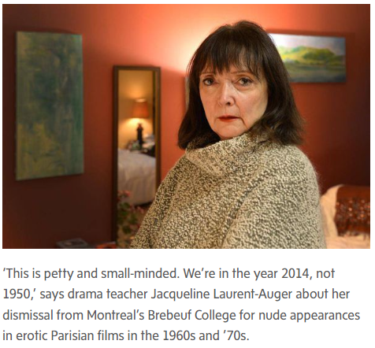
Nudity (2014)
RTBF
“Meanwhile, the school – a Jesuit-founded institution that groomed leaders such as Pierre Trudeau and his son, Justin – has come under attack for a decision characterized as prudish and shortsighted. One blogger called it a case of "retroactive slut-shaming."
Notes:
Montreal teacher, 73, loses job over film nudity more than 40 years ago
https://www.theglobeandmail.com/news/national/montreal-teacher-73-loses-job-over-film-nudity-more-than-40-years-ago/article21183669/

Slide 54
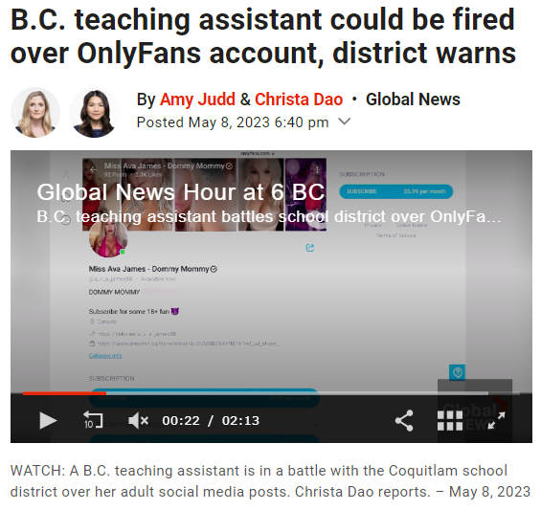
OnlyFans (2023)
RTBF – cog diss
“Quail said, in her opinion, if school districts and the Ministry of Education want to have this kind of control over what education assistants are doing with their lives, then there is a responsibility to pay them a wage that allows them to devote their energy and their attention and skills to being an education assistant.”
Notes:
B.C. teaching assistant could be fired over OnlyFans account, district warns
https://globalnews.ca/news/9683135/bc-teaching-assistant-could-be-fired-onlyfans-account/

Slide 55
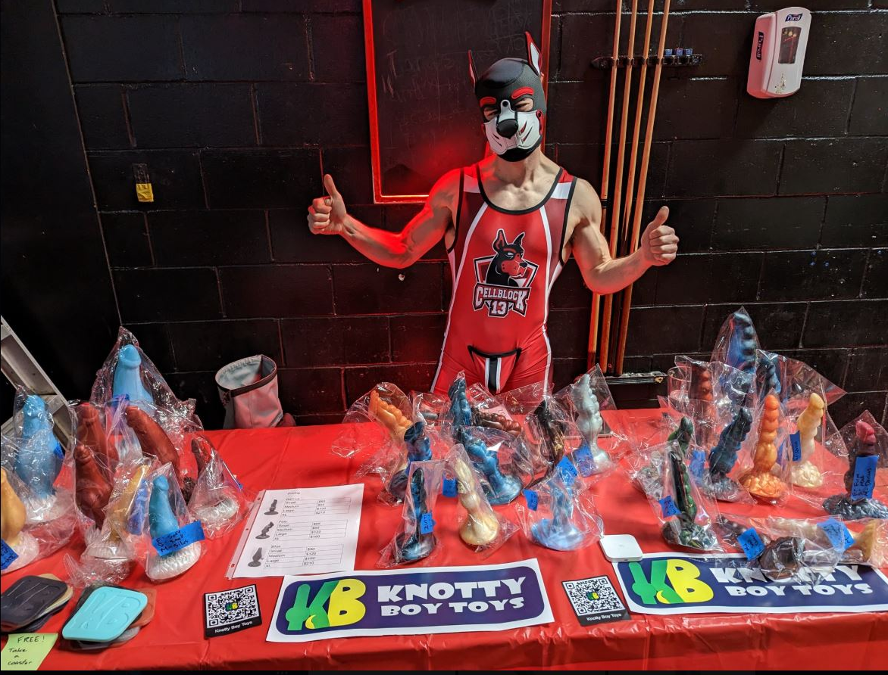
Pornography (2025)
“A Vancouver high school teacher has been suspended after his pup fetish identity and a messaging channel where he shares pornographic content were discovered online, raising questions about where the line lies between teachers’ personal lives and professional expectations.”
Notes:
(May 30, 2025) Vancouver teacher suspended after pup fetish identity, adult content discovered online
https://vancouversun.com/news/vancouver-high-school-teacher-suspended-after-pup-fetish-adult-content-online
* https://archive.ph/87xeI

Slide 56
Connell, R. (2009) “Good teachers”
/ /
“Education is a process that creates social reality, necessarily producing something new. Education is part of the process that steers a society through historical time.”
Questions about the goals of education are questions about the direction in which we want a social order to move, given that societies cannot avoid changing.
This is where questions of privilege and social justice in education arise; they are fundamental to the project, not add-ons.”
╬
Notes:
The Larger Social Purpose of Education
Connell, R. (2009). Good teachers on dangerous ground: towards a new view of teacher quality and professionalism. Critical Studies in Education, 50(3), 213-229, https://doi.org/10.1080/17508480902998421
Transmit - form

Slide 57

A Möbius Trip: Part 1
The Legal Framework: Federal & Provincial
The Canadian Charter of Rights and Freedoms
Seminal Cases
Duty to Report
Teacher as Role Model
Teacher as Change Agent
Curriculum as Contested
Inquiry
A Möbius Trip: Part 2
Extras
Notes:
KF: The case points to how a teacher does not have to be a mere mouthpiece for the curriculum. That they have agency, and perhaps a duty, to introduce the contentious issues into the classroom for the benefit of their students.
"The legal system, like the education system, is in many ways an embodiment of our common social values" and "When values change, the legal system, again like the education system, is called upon to respond" (p. 209)
Kindred, K. (2006). The teacher in dissent: Freedom of expression and the classroom. Education Law Journal, 15(3), 207-23. https://doi.org/10.3138/9781442698819-008
KF: This makes it clear that both the law and education reside within the messiness and mutability of human experience. As society changes, so too must the law. When it comes to freedom of expression, it seems (to me at least) that education is the sandbox wherein these changes manifest which then have to be interpreted and sanctioned by the law after the fact.
Honored by UFV in 2021

Slide 58
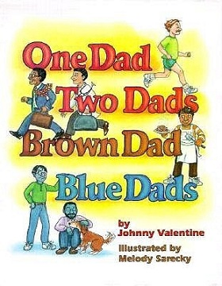
On Cognitive dissonance
"The belief that others are entitled to equal respect depends, not on the belief that their values are right, but on the belief that they have a claim to equal respect regardless of whether they are right"
(Chamberlain v. Surrey School District No. 36, 2002)
Chilling effect
Notes:
An Abbotsford educator’s decade-long fight for representation in classrooms https://fvcurrent.com/article/one-educators-decade-long-fight-for-representation-in-classrooms/
Chamberlain v Surrey School District No 36, [2002] 4 S.C.R. 710, 2002 SCC 86, https://scc-csc.lexum.com/scc-csc/scc-csc/en/item/2030/index.do
Waddington, D.I. (2011). A Right to Speak Out: The Morin Case and its Implications for Teachers’ Free Expression. Interchange, 42(1), 59-80. https://doi.org/10.1007/s10780-011-9146-3
UFV honorary degree 2021: Chamberlain honoured for advocacy for LGBTQ+ rights in school system
https://blogs.ufv.ca/blog/2021/06/ufv-honorary-degree-2021-chamberlain-honoured-for-advocacy-for-lgbtq-rights-in-school-system/

Slide 59
Chilling effect
Dickenson (2005) cautions that, while other professionals are also subject to such scrutiny, “We seem much more ready, however, to see teachers as “crossing the border” and that “This is an occupational liability that needs to be understood and weighed carefully by everyone pondering entry into the profession” (p. 403).
╬
Notes:
Penney, Jonathon, Understanding Chilling Effects (May 28, 2021). 106 Minnesota Law Review ___ (2022, Forthcoming), Available at SSRN: https://ssrn.com/abstract=3855619

Slide 60
Chilling effect
“The true impact of chilling effects is not only that it chills or deters certain speech and activities, but also in doing so, helps foster the production of more conforming speech and activities, which will almost always be more consistent with, and conforming to, existing power structures in society.” (Penney, 2022)
and not just for teachers….
╬
Notes:
Penney, Jonathon, Understanding Chilling Effects (May 28, 2021). 106 Minnesota Law Review ___ (2022, Forthcoming), Available at SSRN: https://ssrn.com/abstract=3855619

Slide 61
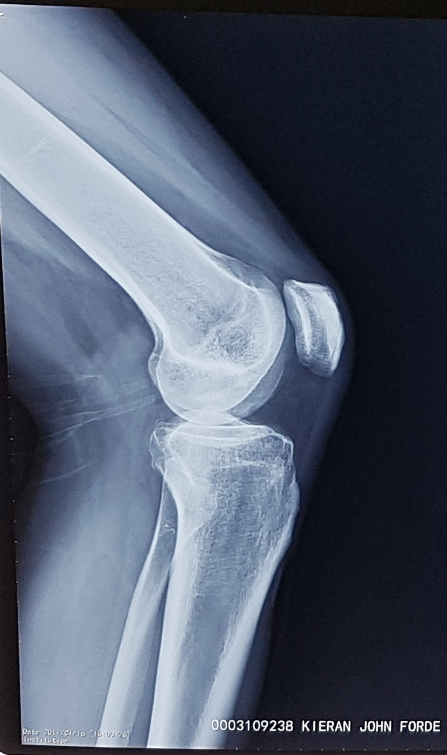
A Möbius Trip: Part 1
The Legal Framework: Federal & Provincial
The Canadian Charter of Rights and Freedoms
Seminal Cases
Duty to Report
Teacher as Role Model
Teacher as Change Agent
Curriculum as Contested
Inquiry
A Möbius Trip: Part 2
Extras
Notes:
Season 6 Episode 2 Back to School Part 2 Little House on the Prairie
https://www.youtube.com/watch?v=qGD4UOh75Bg

Slide 62
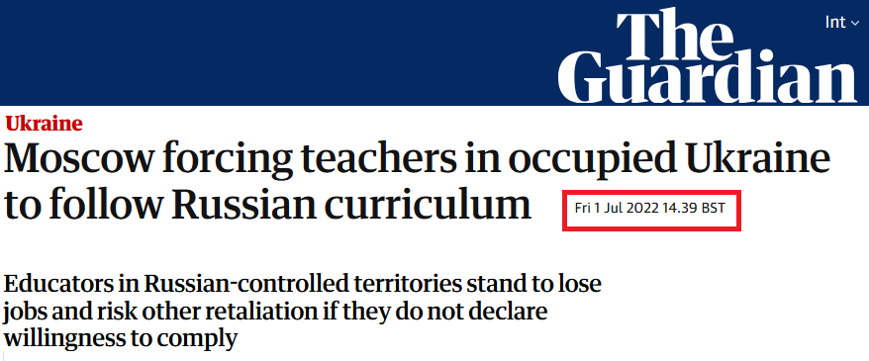
Notes:
(July 1, 2022) Moscow forcing teachers in occupied Ukraine to follow Russian curriculum https://www.theguardian.com/world/2022/jul/01/moscow-forcing-teachers-in-ukraine-to-sign-up-to-russian-curriculum
Moscow forcing teachers in occupied Ukraine to follow Russian curriculum
https://www.theguardian.com/world/2022/jul/01/moscow-forcing-teachers-in-ukraine-to-sign-up-to-russian-curriculum

Slide 63

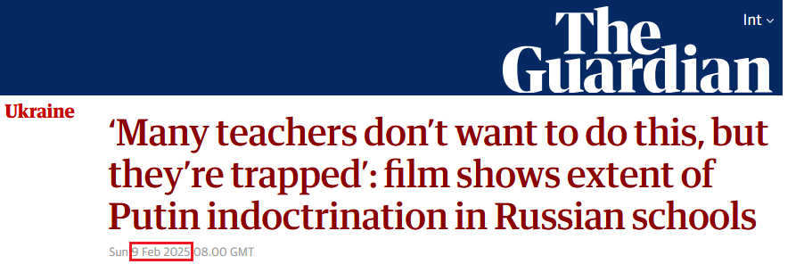
Notes:
(July 1, 2022) Moscow forcing teachers in occupied Ukraine to follow Russian curriculum https://www.theguardian.com/world/2022/jul/01/moscow-forcing-teachers-in-ukraine-to-sign-up-to-russian-curriculum
Moscow forcing teachers in occupied Ukraine to follow Russian curriculum
https://www.theguardian.com/world/2022/jul/01/moscow-forcing-teachers-in-ukraine-to-sign-up-to-russian-curriculum

Slide 64
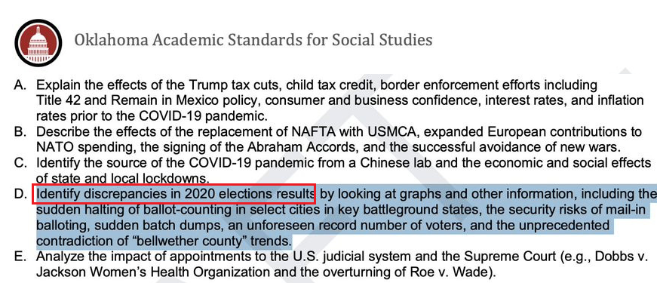
Notes:
“Oklahoma Education Commissar Ryan Walters announces new academic standards for the coming school year. Among other things, all students will be required to learn Trump's version of the 2020 election.”
https://bsky.app/profile/robertscotthorton.bsky.social/post/3lo53toka322c

Slide 65
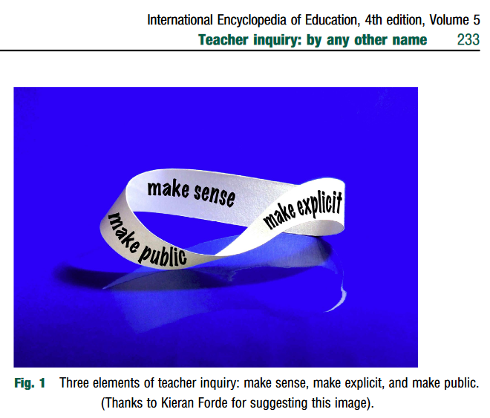
A Möbius Trip: Part 1
The Legal Framework: Federal & Provincial
The Canadian Charter of Rights and Freedoms
Seminal Cases
Duty to Report
Teacher as Role Model
Teacher as Change Agent
Curriculum as Contested
Inquiry
A Möbius Trip: Part 2
Extras
Notes:
Clarke, A. (2023). Teacher inquiry: by any other name. In Tierney, R.J., Rizvi, F., Erkican, K. (Eds.), International Encyclopedia of Education (4th ed.) (Vol. 5, pp. 232–242). Elsevier Science. https://dx.doi.org/10.1016/B978-0-12-818630-5.04026-4

Slide 66
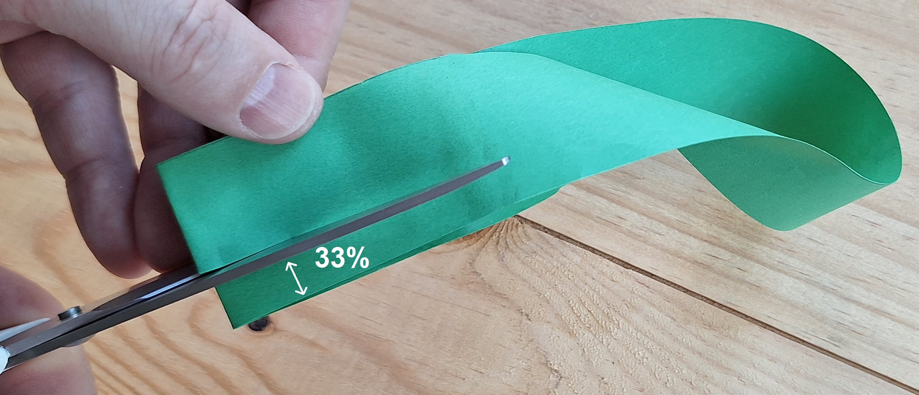

Slide 67
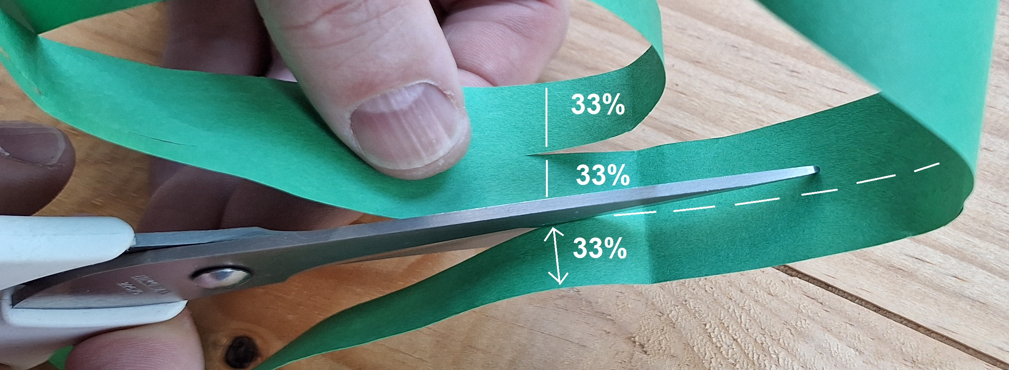
What are you left with?

Slide 68
Be(com)ing a teacher:
Private citizen / Public servant

Slide 69


A Möbius Trip: Part 1
The Legal Framework: Federal & Provincial
The Canadian Charter of Rights and Freedoms
Seminal Cases
Duty to Report
Teacher as Role Model
Teacher as Change Agent
Curriculum as Contested
Inquiry
A Möbius Trip: Part 2
Extras

Slide 70
Extras
Notes:
Forde, K. & Petrina, S. (2021). Design of the pre-service teacher’s digital self. In Anderson, D., MilnerBolotin, M., Santos, R., & Petrina, S. (Eds.), Proceedings of the 6th International STEM in Education Conference (STEM 2021) pp. 446-452. University of British Columbia, Vancouver, Canada, July 5-9. University of British Columbia. https://doi.org/10.14288/1.0402129
Freedom of expression for teachers in K-12 in British Columbia

Slide 71

Student freedom of expression under threat: Hamber / Bateman
“Education student punished for questioning decolonization sues UWO”
Reasonable limits (on–campus protests)
Teachers are public servants (School boards; DEI in Ontario)
Holocaust Education (BC)
Compelled Speech
District Social Media Policy
“The Line”
Translink
Möbius, all the wayback
The Crown 🍁☘️

Slide 72
Student freedom of expression under threat: Hamber / Bateman
“Education student punished for questioning decolonization sues UWO”
Reasonable limits (on–campus protests)
Teachers are public servants (School boards; DEI in Ontario)
Holocaust Education (BC)
Compelled Speech
District Social Media Policy
“The Line”
Translink
Möbius, all the wayback
The Crown 🍁☘️
The 8 Best Non-Alcoholic Beers Have All the Flavor, Minus the Booze
https://www.saveur.com/shop/best-non-alcoholic-beer/
(PAUL FLESSLAND/GETTY IMAGES

Slide 73
      Student Freedom of Expression (under threat)

Slide 74
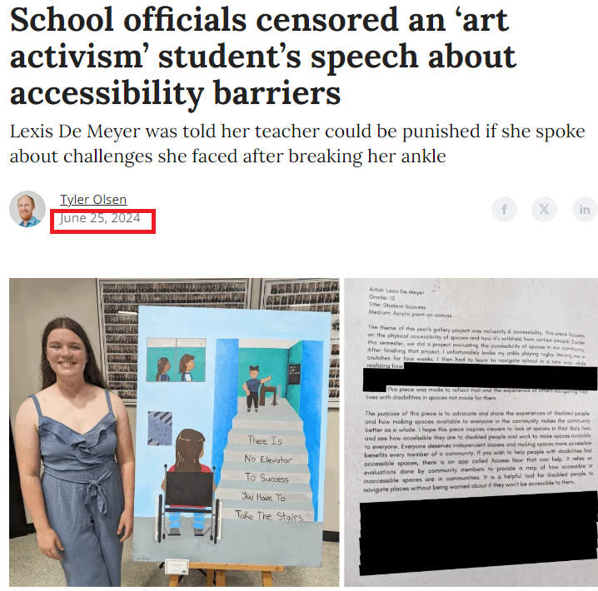
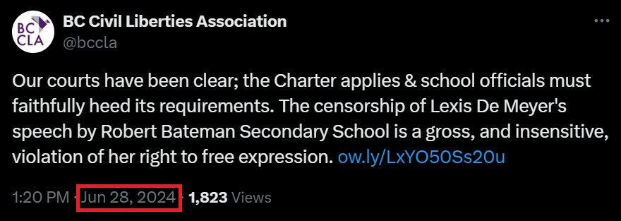
Robert Bateman Secondary, Abbotsford.
Notes:
(June 25) School officials censored an ‘art activism’ student’s speech about accessibility barriers https://fvcurrent.com/p/robert-bateman-art-activism
(July 4, 2024) Censored Abbotsford student disappointed by school's follow-up after apology. https://www.aldergrovestar.com/news/censored-abbotsford-student-disappointed-by-schools-follow-up-after-apology-7426981
BCCLA: https://x.com/bccla/status/1806784695255912539

Slide 75
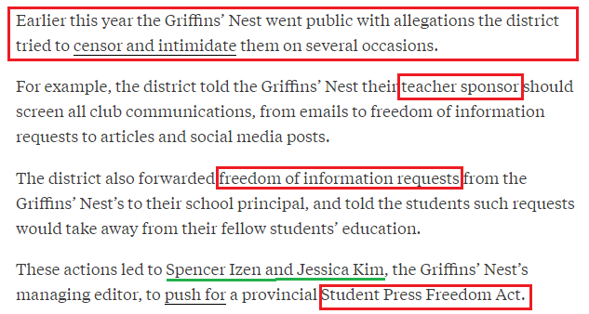
Eric Hamber Secondary, VSB
Notes:
(June 1, 2022) Vancouver School Board Is Violating Charter Rights, Say Student Journalists https://thetyee.ca/News/2022/06/01/Vancouver-School-Board-Violating-Charter-Rights/

Slide 76
      UWO BEd Lawsuit
Notes:
UWO BEd Lawsuit

Slide 77
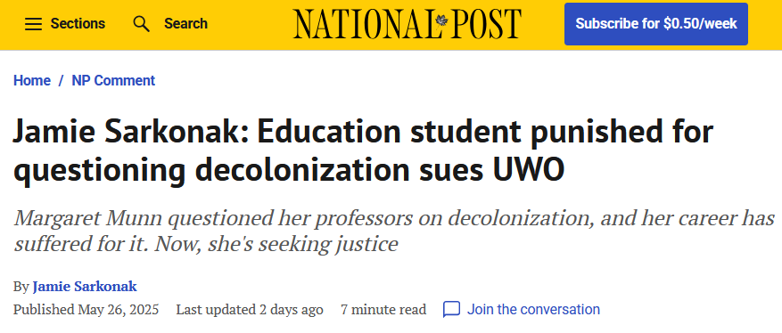
?
“Munn was also reported, allegedly,…for stating that people are innocent until proven guilty and that “ogling isn’t a crime” in a class discussion about a teacher’s duty to report potential abuse”
Notes:
(Mar 26, 2025) Jamie Sarkonak: Education student punished for questioning decolonization sues UWO
https://nationalpost.com/opinion/jamie-sarkonak-education-student-punished-for-questioning-decolonization-sues-uwo
https://archive.ph/3jIGV : Reddit

Slide 78
      Reasonable Limits
      (on-campus protest camps)

Slide 79
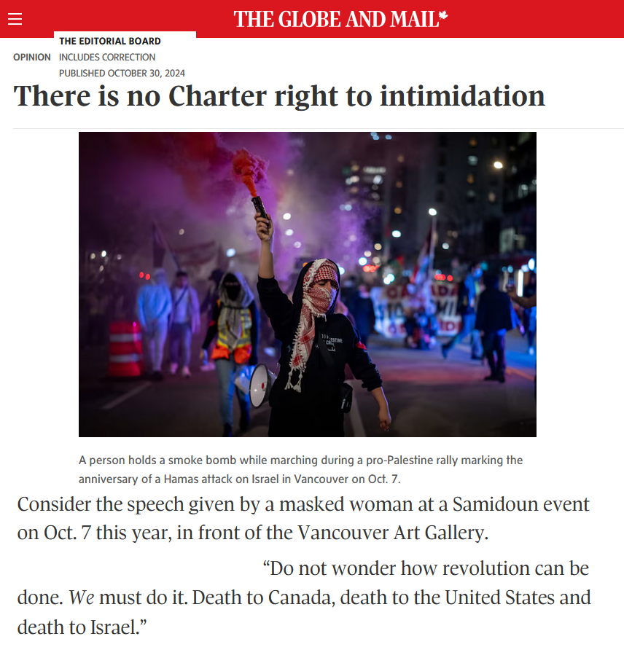
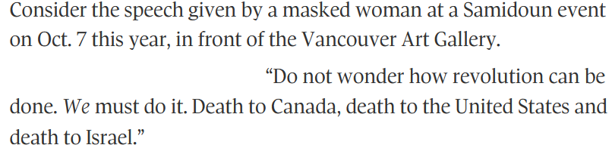
Notes:
Op-Ed. (Oct 7, 2024). There is no Charter right to intimidation. https://archive.is/wWlJb#selection-2449.0-2449.41

Slide 80
      Teachers are Public Servants

Slide 81
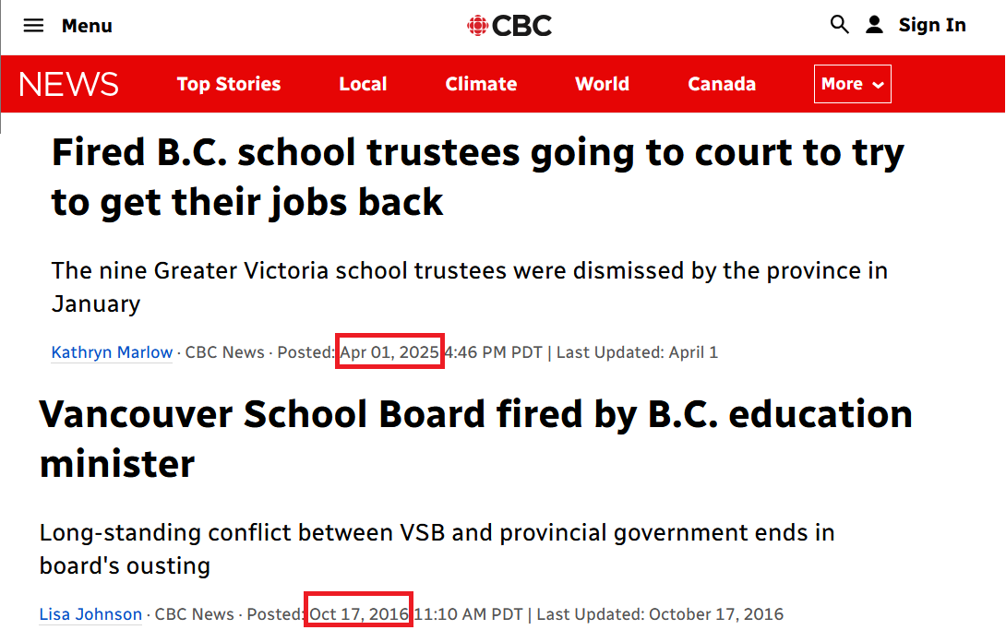
Notes:
VSB can hire / fire you: you work for them
Government can fire VSB: they work for the government
In this arrangement, you, as a sort of sub-contractor, work for the government.

Slide 82
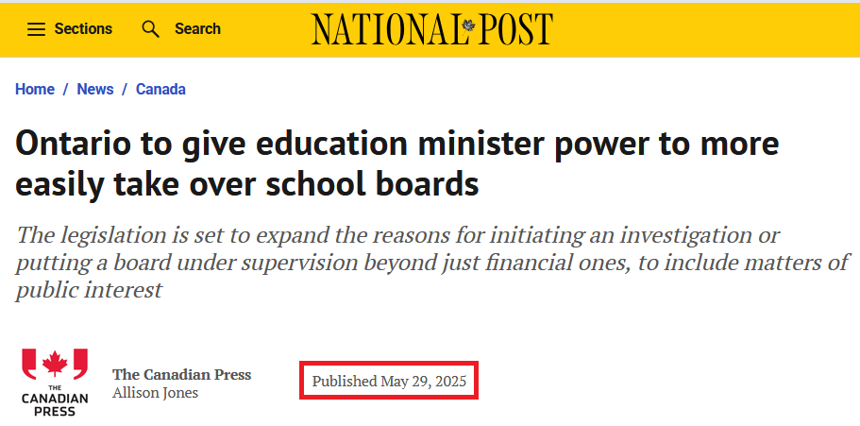
Notes:
(Jun 5, 2025) Randall Denley: Ontario is finally forcing out DEI from schools and universities
https://nationalpost.com/opinion/ontario-is-finally-forcing-out-dei-from-schools-and-universities
(May 29, 0205) Ontario to give education minister power to more easily take over school boards
https://nationalpost.com/news/canada/ontario-to-give-education-minister-power-to-more-easily-take-over-school-boards

Slide 83
      Holocaust Education

Slide 84
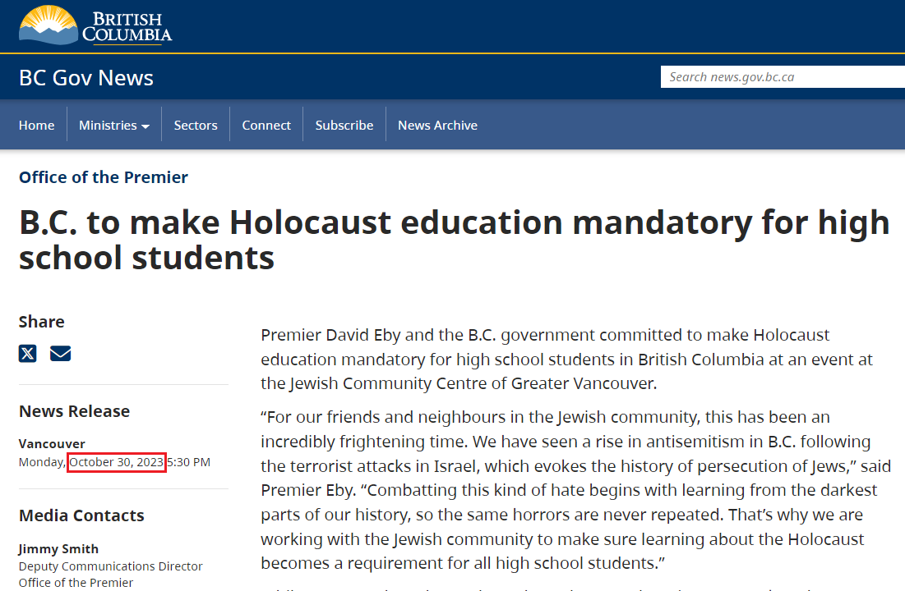
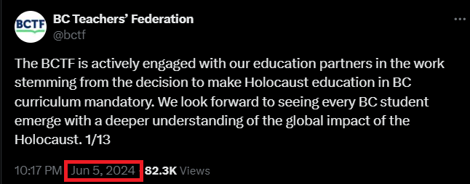
Antisemitism
Notes:
B.C. to make Holocaust education mandatory for high school students
https://news.gov.bc.ca/releases/2023PREM0077-001688#
Variability in employment market: TTOC; [Language teachers]

Slide 85
      Compelled Speech / 2(a)

Slide 86
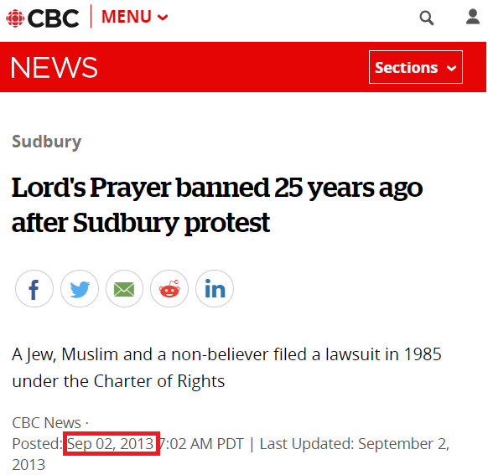
“The decision also noted that because school plays a huge part in a child’s life, and children are not capable of independent, adult thought, the prayer’s presence could be construed as compulsion. The ruling also said that excluding children from the prayer stigmatized them, coercing them into conforming to the rest of the class.”
In 1988
Notes:
(Sep 02, 2013) Lord's Prayer banned 25 years ago after Sudbury protest
https://www.cbc.ca/news/canada/sudbury/lord-s-prayer-banned-25-years-ago-after-sudbury-protest-1.1359913
"I think it's unfortunate that the spirit that motivated us, which is one of inclusion, could be morphed into one that aims to do the opposite. One that aims to tell people of faith that they're not welcome," he said.
See (Sept 5, 2023) Religion in Public School Acts https://www.bchumanist.ca/religion_in_public_school_acts

Slide 87
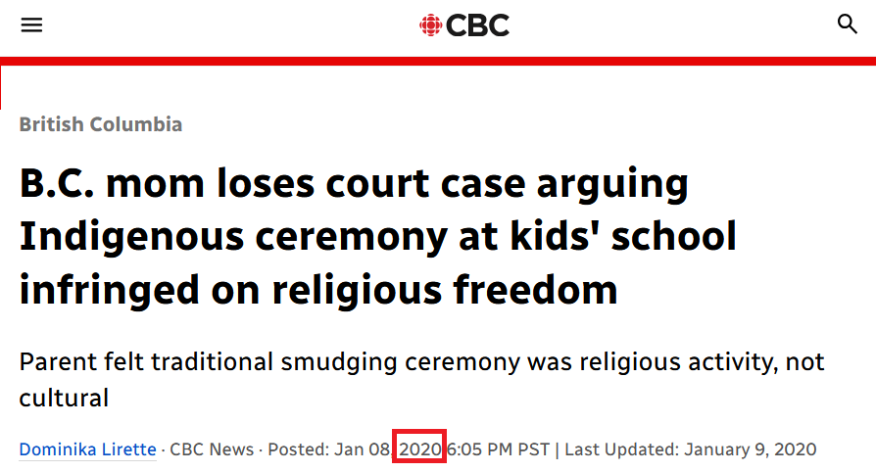
In 2020, B.C. Supreme Court Justice Douglas Thompson ruled that both events were not religious ceremonies but demonstrations designed to teach students about Indigenous culture — and that students were not forced to participate.
Notes:
(Jan 8, 2020) B.C. mom loses court case arguing Indigenous ceremony at kids’ school infringed on religious freedom
https://www.cbc.ca/news/canada/british-columbia/mom-lose-case-indigenous-ceremony-school-religious-freedom-1.5420103
See: Servatius v. Alberni School District No. 70 https://kieranfor.de/2024/09/30/servatius-v-alberni-school-district-no-70/

Slide 88
      District Social Media Policy

Slide 89
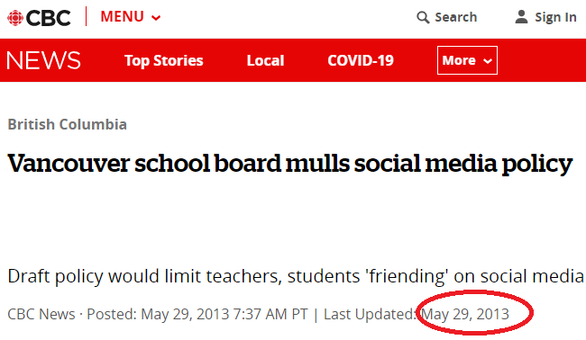
Policy
The challenge for school boards involves balancing an employee's right to freedom of expression and personal privacy with the need to ensure a respectful and positive learning and teaching environment” (Roher and Zavitz (2011) p. 246).
“If teachers associations and the teaching profession do nothing to claim their right to participate in setting the moral standards off-duty teacher conduct, the situation will remain as it is today—the task of sorting these matters out will be left to the whims of public opinion, the vagaries of school authorities’ moral intuitions, and the sometimes questionable reasoning of judges. (Maxwell, 2018, p. 176)
May 11, 2022
Administrative Procedure 403 SOCIAL MEDIA GUIDELINES
Notes:
Roher, E.M., & Zavitz, K.A. (2011). Facebook, MySpace, Twitter & blogs: How to manage social media in a school employment context. In R. Flynn (Ed.), The Rocky Road Ahead: Balancing Competing Interests.(pp. 223-247).
Administrative Procedure 403 SOCIAL MEDIA GUIDELINES
https://www.vsb.bc.ca/District/Departments/Office_of_the_Superintendent/Administrative-Procedures-Manual/Administrative%20Procedures%20Manual%20Library/Section%20400/AP_403_Social_Media_Guidelines.pdf

Slide 90
“If teachers associations and the teaching profession do nothing to claim their right to participate in setting the moral standards off-duty teacher conduct, the situation will remain as it is today—the task of sorting these matters out will be left to the whims of public opinion, the vagaries of school authorities’ moral intuitions, and the sometimes questionable reasoning of judges. (Maxwell, 2018, p. 176)
Notes:
Roher, E.M., & Zavitz, K.A. (2011). Facebook, MySpace, Twitter & blogs: How to manage social media in a school employment context. In R. Flynn (Ed.), The Rocky Road Ahead: Balancing Competing Interests.(pp. 223-247).
Administrative Procedure 403 SOCIAL MEDIA GUIDELINES
https://www.vsb.bc.ca/District/Departments/Office_of_the_Superintendent/Administrative-Procedures-Manual/Administrative%20Procedures%20Manual%20Library/Section%20400/AP_403_Social_Media_Guidelines.pdf

Slide 91
      “The Line”

Slide 92

Where is “the line”?

Slide 93
      Translink

Slide 94
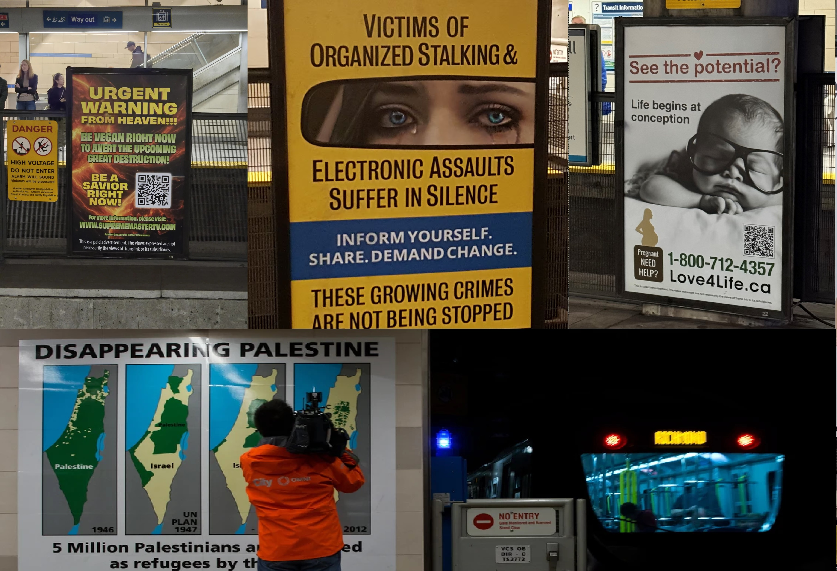

Slide 95
      Möbius all the way down

Slide 96
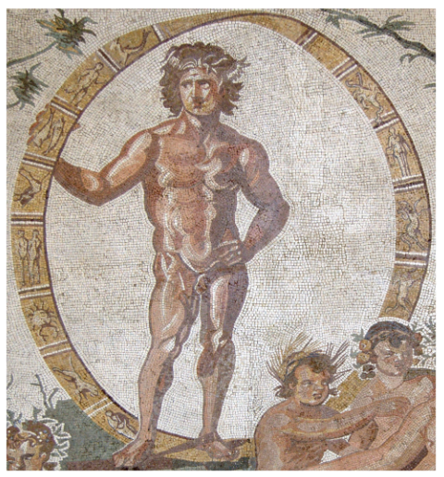
Möbius strips before Möbius
Notes:
Cartwright, J. H. E., & González, D. L. (2016). Möbius strips before Möbius: Topological hints in ancient representations. The Mathematical Intelligencer, 38(2), 69-76. https://doi.org/10.1007/s00283-016-9631-8
August Mobius discovered his eponymous strip—also found almost contemporaneously by Johann Listing—in 1858,
Central part of the great Sentinum mosaic (dated to 200–250 CE) showing the Mobius band. (Image from Bibi Saint-Pol / Wikimedia Commons.)

Slide 97


      The Crown

