Slide 1
Pre-service TechEd teachers and their conceptual metaphors of teaching and learning
2023 Virtual SoTL Summit
Kennesaw State University
Kieran Forde
PhD candidate, The University of British Columbia
September 21, 2023
Kolb’sn’t
Notes:
SoTL project as pilot for CATL: https://ctlt.ubc.ca/programs/all-our-programs/graduate-program-in-advanced-teaching-and-learning/
UBC BREB NUMBER: H23-00182 (approval for secondary use of data)
u/nidje_veze_ (2020, December 8). Doors are tricky [Video]. Reddit. https://www.reddit.com/r/funny/comments/k9652v/doors_are_tircky

Slide 2
Terms
Pre-service TechEd teachers
Teacher Candidates
Technology Education: Part of British Columbia Applied Design, Skills and Technologies Curriculum – “Shop Class”
“Metaphors are a non-literal use of language; for example, when we say that “my dog flew across the garden to chase the squirrel,” we do not mean that the dog literally grew wings and flew. Metaphors can be seen as a super-category of all such uses of language, including analogy and simile” (Weller, 2022, p. 6)
Notes:
Teacher Candidates: transitioning
Technology Education: Applied Design, Skills and Technologies Curriculum in BC
You may know this group as “Shop Class” teachers
Allowed myself a broad definition of Metaphor, flowing Weller..
Weller, M. (2022). Metaphors of Ed Tech. Athabasca University Press. https://doi.org/10.15215/aupress/9781771993500.01

Slide 3
Literature review sample
“Metaphor is pervasive in everyday life, not just in language but in thought and action” (p. 3)
“A large part of self-understanding is the search for appropriate personal metaphors that make sense of our lives” (p. 233)
(Lakoff & Johnson, 1980)
“[T]eacher educators have long recognized the intimate relationship between metaphors and teacher identity” (p. 201)
“Metaphors play a role in the process of teacher self-formation and self-exploration" (p. 200)
(Bullough & Stokes, 1994)
Notes:
There has been LOTS of research intro metaphor, of course. Just a tiny sample of that here (more in the reference section)
(Lakoff & Johnson, Metaphors we live by, 1980, p. 3)
Bullough & Stokes point out…

Slide 4
Purpose / SoTL project
Explore how metaphor can be used as a teaching tool for reflective practice
Make transparent TCs’ conceptual metaphors for teaching learning when they entered the profession
Investigate if TCs’ conception of teaching and learning, as expressed by specific teaching metaphors, change over time.
Discern whether my focus on metaphor encouraged my students to think more “metaphorically”
Notes:
Project initiated as pilot for teaching and learning certificate course: https://ctlt.ubc.ca/programs/all-our-programs/graduate-program-in-advanced-teaching-and-learning/
My purpose was to…

Slide 5
The Students
N = 22 Bachelor of Education Technology Education teacher candidates (TCs)
19 male; 3 female
Many with trades backgrounds (Red Seal) &/ working with young people
All having completed the 2-year Technology Teacher Education program at British Columbia Institute of Technology
Notes:
Technology Teacher Education
https://www.bcit.ca/programs/technology-teacher-education-diploma-full-time-605ddipma/

Slide 6
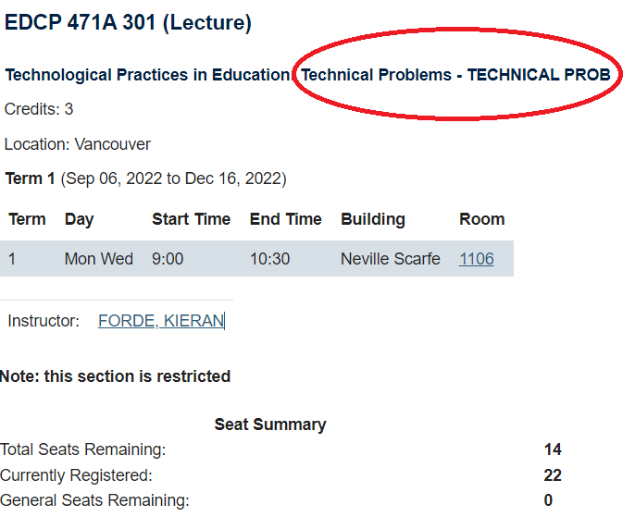
The Course
"It may well be that academic knowledge is essential only as an entitlement to practice and is not functionally necessary for practice.”
(Shulman, 1997, p. 12)
Notes:
Shulman (1997). Professing the liberal arts. Teaching as community property. Jossey-Bass

Slide 7
The Study
Mixed methods
Quantitative – Metaphor Survey: Week 2 / Week 13
Qualitative – Teaching Philosophy Discourse analysis: Week 2 / Week 13
Limitations
Notes:
Limitations:
N = 22 (somewhat overwhelmed TCs)
M/F ratio: 19 male; 3 female
Niche subject ~ a group used to working with their hands in a very different context to teachers of other subjects.
Involves some speculation; couldn’t instruct them to “use metaphors” so, in some cases, I found “flakes rather than nuggets”
But….something did happen….
Ginn, M. [@shutupmikeginn]. (2014, September 7). We get it poets: things are like other things [Tweet]. Twitter. https://twitter.com/shutupmikeginn/status/508799244778889216

Slide 8
Metaphor Survey: Week 2 / Week 13

Slide 9
After Alger (2009)
Notes:
Alger (2009) who distilled 23 studies representing 1053 teacher-generated metaphors down to six categories.
I then offered these choices and, like Alger, the opportunity to create their own metaphor if none of these appealed to my students.
Students replied via Google Forms
Alger, C. L. (2009). Secondary teachers' conceptual metaphors of teaching and learning: Changes over the career span. Teaching and Teacher Education, 25(5), 743-751. https://doi.org/10.1016/j.tate.2008.10.004
Guess what they chose!

Slide 10
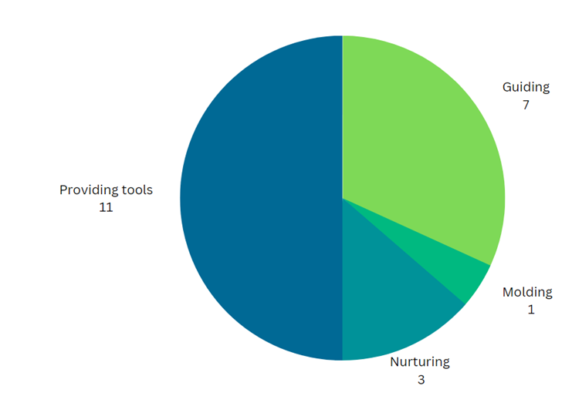
Week 2
X Engaging with Community X Transmitting X Personal Metaphor
Notes:
“Developing metaphors might, however, appeal only to the more linguistically inclined student teachers” (Grimmett & Mackinnon, 1992)
“the nature of the parent discipline and features of the school subject, as well as teachers' beliefs regarding the subject, help create a conceptual context within which teachers work” (Grossman& Stodolsky, 1995, p. 5)
Week 1
Half of the group chose providing tools. Given that many of these students come from a trades background and that they entered UBC via the 2-year Diploma program in Technology Teacher Education at BCIT where they spent most of their time working with tools and machines.
A third selected Teaching is Guiding as the best fit
3 chose nurturing and 1 chose molding
None of the students chose Engaging in community, Transmitting, and none chose to write their own metaphor.

Slide 11
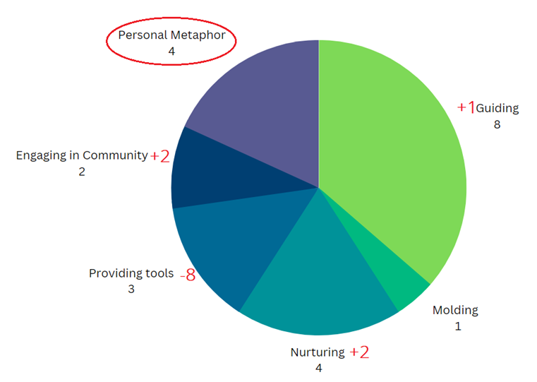
Week 13
X Transmitting

Slide 12
Week 13: Personal Metaphors
1. “Teaching is Building a House In order to build a house one must build a solid foundation and frame….” (Student 1)
2. “Teaching is captaining a ship - lots of things going on simultaneously, sometimes out of sight on board…” (Student 2)
Choices rejected; Reaching for their own concept…
3. “Teaching is building and maintaining curiosity…” (Student 3)
4. “Teaching is complex, it's neither one nor the other, but situational in nature. Teaching is diverse…” (Student 4)

Slide 13
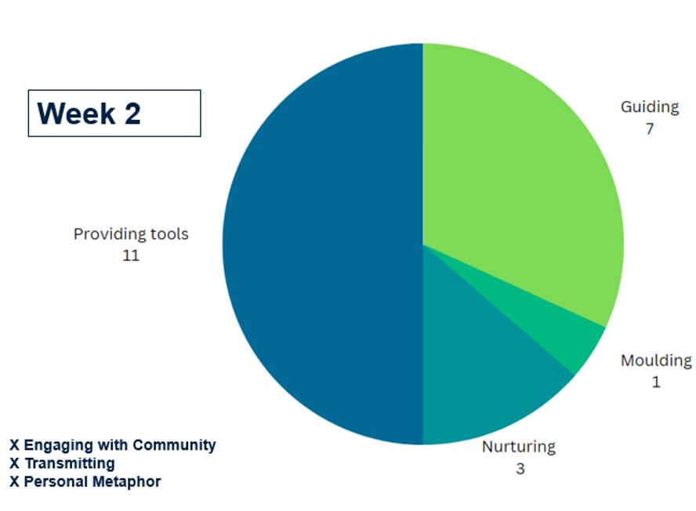
Week 2
Week 13
Week 13
X Transmitting
Something happened!!
Notes:
In short, 12 of the 22 students changed from their original conceptualization of what the thought they were doing.
Something happened. Why and how?

Slide 14
Teaching Philosophy Discourse analysis: Week 2 / Week 13

Slide 15
Begin drafting your own teaching philosophy
The purpose of education is to________.
Technology education is __________________.
Students learn best by______________.
The greatest impediment to learning is __________________.
I want to teach my subject because ___________.
The most important aspects of my teaching are______________.
When I am teaching my subject, my goals are to ___________.
The most effective methods for teaching are___________.
I know this because__________________.
My students are motivated to learn when __________________.
Notes:
V1.0 Week 2 - Sept 14: In that same week, I gave a lesson on Teaching Philosophies and had students begin to draft theirs by completing the sentences above. About half of the group merely completed the sentences while the rest expanded these into paragraphs, with some drafting a complete first draft.

Slide 16
Metaphors in Teaching Philosophy 1.0 = 3 + 2
As teachers/educators, our job is to be a custodian of an educational safe place that respects individuality, creates opportunities, facilitates equal access and encourages students to creatively explore “big ideas” both inside and outside of the classroom.
Doing coaching in the past I have played around with different styles of coaching and have been building my teaching style through sports.
The most effective teaching method is to be approachable and open to "coaching" students based on their specific needs.
(+ 2 from choices offered guide / nurture)
╬

Slide 17
Metaphors in Teaching Philosophy 1.1 = 9 + 2
I originally believed that the role of a teacher was to provide tools, however, after spending some time at UBC, I now believe that the role of a teacher is to be a guide for students.
The argument that this could be a constant up hill "Sisyphean" style of journey is entirely relevant…
Teaching is an art. And just like an artist, each teacher must develop their own unique style to be truly great at their craft. I can feel my own style developing…
This is especially important to me as I view the curricular content of my classes as the vehicle that brings us to the core competencies and big ideas.
Notes:
V1.1 End of Week 12 - Dec 9:
Rpt x3
As teachers/educators, our job is to be a custodian of an educationally brave place that respects Individuality, creates opportunities, and facilitates equal access and unbiased encouragement to students for them to creatively explore “big ideas” both inside and outside of the classroom.
The most effective teaching method is to be approachable and open to "coaching" students based on their specific needs.
The purpose of education is to be the vessel in which learning, inspiration, and systematic instruction can take place so that all those involved can learn and grow together for both their individual and collective betterment.
I know this from my experiences coaching over the period of twelve years.

Slide 18
Metaphors in Teaching Philosophy 1.1 = 9 + 2
Sometimes you think you have developed bulletproof instructions, accompanied by visual aids, but students may not understand. This is where you need to be comfortable using metaphors or other ways of explaining the concept.
I have always looked at my future classroom as a melting pot, a cauldron bubbling up with the strange mixture of my personality, the students, and the material. While I can influence two of those things one of those ingredients will never be fully of my choosing, …
Schools are a place of storms and many students feel like they are adrift in a sea of hormones, and creating a rock in the water can be a breathing place that gets them through the day.
Notes:
V1.1 End of Week 12 - Dec 9:

Slide 19
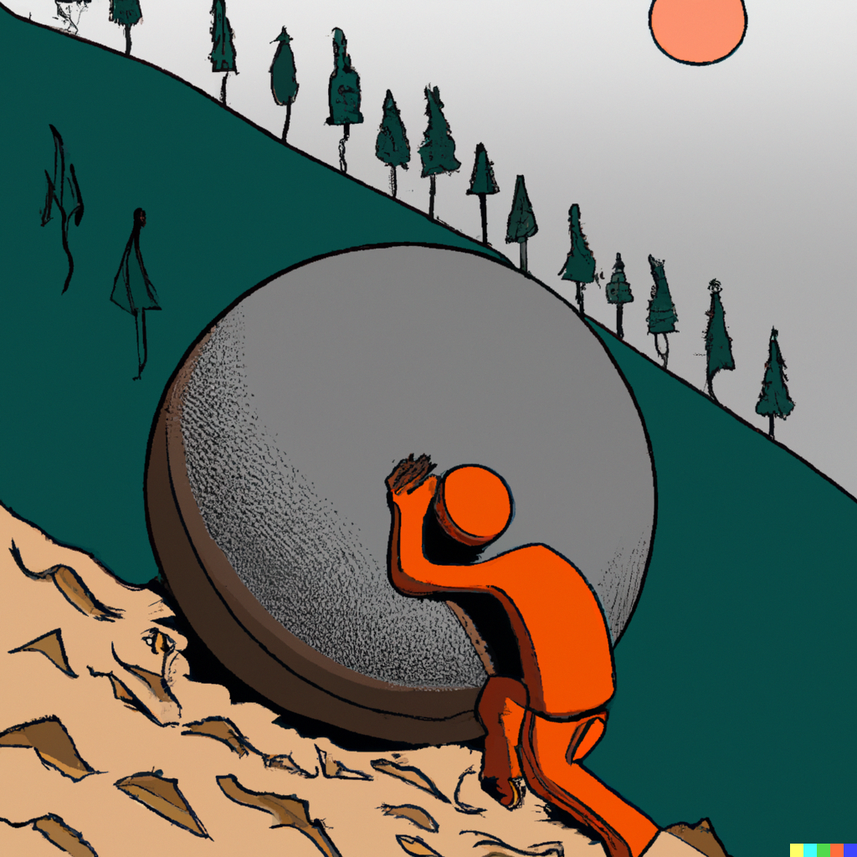
Metaphors in TP 1.0 (Week 2) = 3 + 2
Metaphors in TP 1.1 (Week 13) = 9 + 2
Something happened!!
Notes:
Images generated by Kieran in Dall-E

Slide 20
What Happened?
1. Week 2: TCs just starting their BEd
Transitioning: student – TC – proto-professional
Seeking / forming “teacher identity”
“[T]he central role played by a novice's image of self as teacher emerges once again as an important theme in studies of professional growth.” (Kagan, 1992)
2. By Week 13: TCs had inquiry, edpsych, practicum, LLED….
My class
Notes:
Images generated by Kieran in Dall-E
Kagan highlights:
“the central role played by a novice's image of self as teacher emerges once again as an important theme in studies of professional growth.” (p. 146)
Kagan, D. M. (1992). Professional growth among preservice and beginning teachers.
As with (Bullough & Stokes, 1994), I was surprised by the amount of evidence of critical reflection, as the TCs seemed to have an increasing awareness of the requirements that the cognitive transition from student, to teacher candidate, to proto-professional.

Slide 21
Conclusion: Head, Heart, Hands – Metaphors Matter
“Metaphors matter. People who see technology as a tool see themselves controlling it.
People who see technology as a system see themselves caught up inside it.
We see technology as part of an ecology, surrounded by a dense network of relationships in local environments” (p. 27)
Nardi, B. A., & O'Day, V. (1999;2000;). Information ecologies: Using technology with heart.
╬╬
Notes:
Image generated by Kieran in MidJourney
Ss conceptual framework for their role changed as the semester progressed.
Ss use of metaphor increased, with the increase of personal metaphors suggesting that metaphor played a role in helping students reconsider their teacher identity.
Ss came to better understand that both teaching and TE is a coming together of the HHH, as they embraced the theoretical / “pedagogical component” of the BEd.
Given the students involved were TechEd teachers, I want to finish with an awesome quote:
Explore how metaphor can be used as a teaching tool for reflective practice
Make transparent TCs’ conceptual metaphors for teaching learning when they entered the profession
Investigate if TCs’ conception of teaching and learning, as expressed by specific teaching metaphors, change over time.
Discern whether my focus on metaphor encouraged my students to think more “metaphorically”
Sipos, Y., Battisti, B. & Grimm, K. (2008). "Achieving transformative sustainability learning: engaging head, hands and heart". International Journal of Sustainability in Higher Education, 9(1), 68-86. https://doi.org/10.1108/14676370810842193
“corresponding to cognitive ( head ), psychomotor ( hands ) and affective ( heart ) domains of learning that facilitate personal experience for participants resulting in profound changes in knowledge, skills and attitudes related to enhancing ecological, social and economic justice.” (p. 69)

Slide 22
References (1/2)
Alger, C. L. (2009). Secondary teachers' conceptual metaphors of teaching and learning: Changes over the career span. Teaching and Teacher Education, 25(5), 743-751. https://doi.org/10.1016/j.tate.2008.10.004
Bullough, R. V., Jr, & Stokes, D. K. (1994). Analyzing personal teaching metaphors in preservice teacher education as a means for encouraging professional development. American Educational Research Journal, 31(1), 197-224. https://doi.org/10.3102/00028312031001197
Ginn, M. [@shutupmikeginn]. (2014, September 7). We get it poets: things are like other things [Tweet]. Twitter. https://twitter.com/shutupmikeginn/status/508799244778889216
Grimmett, P., & Mackinnon, A. (1992). Craft knowledge and the education of teachers. Review of Research in Education, 18, 385-456. https://doi.org/10.3102/0091732X018001385
Grossman, P. L., & Stodolsky, S. S. (1995). Content as context: The role of school subjects in secondary school teaching. Educational Researcher, 24(8), 5-23. https://doi.org/10.3102/0013189X024008005
Kagan, D. M. (1992). Professional growth among preservice and beginning teachers. Review of Educational Research, 62(2), 129-169. https://doi.org/10.3102/00346543062002129
Lakoff, G., & Johnson, M. (1980). Metaphors we live by. University of Chicago Press.
Liu, E. (2006). Guiding lights: How to mentor-and find life's purpose.
Mahlios, M., & Maxson, M. (1998). Metaphors as structures for elementary and secondary preservice teachers’ thinking. International Journal of Educational Research, 29(3), 227-240. https://doi.org/10.1016/S0883-0355(98)00027-5

Slide 23
References (2/2)
Nardi, B. A., & O'Day, V. (1999;2000;). Information ecologies: Using technology with heart. MIT Press. https://doi.org/10.7551/mitpress/3767.001.0001
Sipos, Y., Battisti, B. & Grimm, K. (2008). "Achieving transformative sustainability learning: engaging head, hands and heart". International Journal of Sustainability in Higher Education, 9(1), 68-86. https://doi.org/10.1108/14676370810842193
Stofflett, R. (1996). Metaphor development by secondary teachers enrolled in graduate teacher education. Teaching and Teacher Education, 12(6), 577-589. https://doi.org/10.1016/S0742-051X(96)00002-9
u/nidje_veze_ (2020, December 8). Doors are tircky [Video]. Reddit. https://www.reddit.com/r/funny/comments/k9652v/doors_are_tircky
Weller, M. (2022). Metaphors of Ed Tech. Athabasca University Press. https://doi.org/10.15215/aupress/9781771993500.01
Wolodko, B. L., Willson, K. J., & Johnson, R. E. (2003). Metaphors as a vehicle for exploring preservice teachers' perceptions of mathematics. Teaching Children Mathematics, 10(4), 224-229.

Slide 24
Extras

Slide 25
Literature review sample
“The personal beliefs and images that preservice candidates bring to programs of teacher education usually remain inflexible. Candidates tend to use the information provided in course work to confirm rather than to confront and correct their pre-existing beliefs. Thus, a candidate's personal beliefs and images determine how much knowledge the candidate acquires from a preservice program and how it is interpreted” (p. 154)
(Kagan, 1992)
“[O]ne of the reasons why some teacher education students fail to adequately learn salient program concepts and practices is because there are conflicting analogic metaphors between those of students and university faculty about children, learning, schooling, curriculum, teaching, and so on” (p. 239)
(Mahlios & Maxson, 1998)

Slide 26
Literature review sample
“Developing metaphors might, however, appeal only to the more linguistically inclined student teachers. For the more visually oriented student teacher, it would be possible to have them draw pictures of such ideas as ‘school,’ ‘classroom,’ ‘students,’ ‘good teaching,’ and ‘memorable learning experiences’ (p. 434)
(Grimmett & Mackinnon, 1992).
Notes:
Grimmett, P., & Mackinnon, A. (1992). Craft knowledge and the education of teachers. Review of Research in Education, 18, 385-456. https://doi.org/10.3102/0091732X018001385

Slide 27
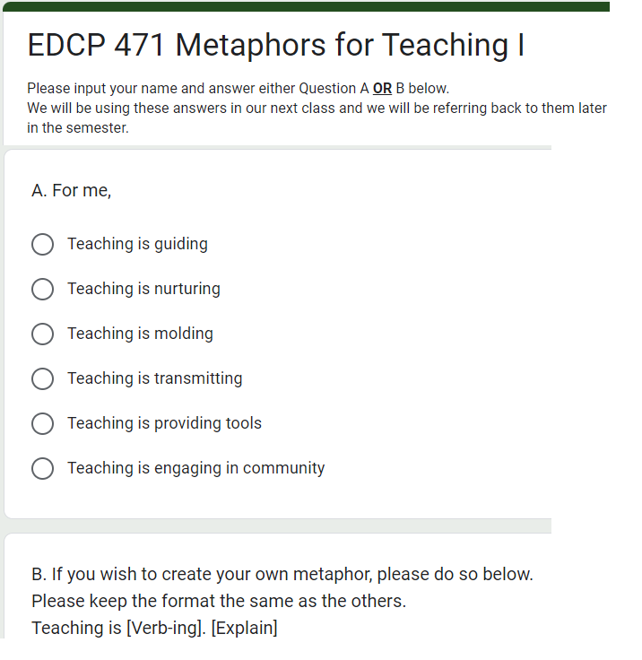
Notes:
Google forms: Organizing principle for a survey, created by Alger (2009) who distilled 23 studies representing 1053 teacher-generated metaphors down to six categories.
I then offered these choices and, like Alger, the opportunity to create their own metaphor if none of these appealedto my students.
Alger, C. L. (2009). Secondary teachers' conceptual metaphors of teaching and learning: Changes over the career span. Teaching and Teacher Education, 25(5), 743-751. https://doi.org/10.1016/j.tate.2008.10.004

